Slide 1
MH/SUD Workforce Data
May 17, 2022

Slide 2
Acknowledgements
Partners
National Council for Mental Wellbeing
UMich Behavioral Health Workforce Research Center
HealthLandscape
Funding
This project was funded under grant number H79FG000028 from the Substance Abuse and Mental Health Services Administration (SAMHSA), U.S. Department of Health and Human Services (HHS). The views, policies, and opinions expressed do not necessarily reflect those of SAMHSA or HHS, and should not be construed as such.

Slide 3
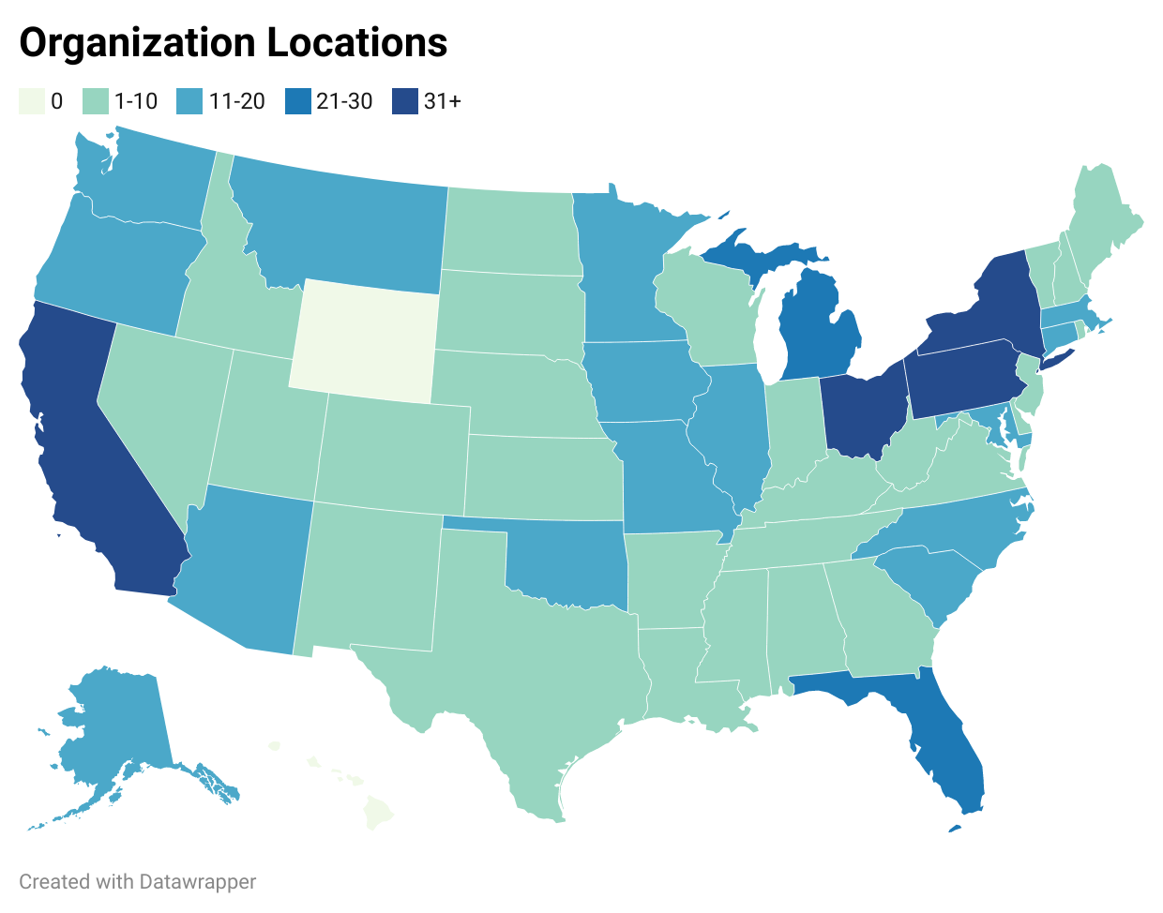
Employer Survey
Electronic survey conducted via Qualtrics
Domains: organizational characteristics, staffing, recruitment & retention needs
Fielded in September–November 2021
Sample: all National Council for Mental Wellbeing provider organization member points of contact (n=2307)
Invited via email with reminders for non-respondents
Received 496 responses (21.5% response rate)
113 certified community behavioral health centers (CCBHCs)
Preliminary results – not for citation

Slide 4
Clinical Staff Employed
Preliminary results – not for citation

Slide 5
Difficulty Recruiting + Retaining Clinical Staff
Preliminary results – not for citation

Slide 6
Support Staff Employed
Preliminary results – not for citation

Slide 7
Difficulty Recruiting + Retaining Support Staff
Preliminary results – not for citation

Slide 8
Reasons Behind Recruitment Challenges
Preliminary results – not for citation

Slide 9
Strategies for Addressing Workforce Gaps
Percent of Responses
Preliminary results – not for citation

Slide 10
Staffing Adequacy by Service Area
How would you rate the adequacy of your organization’s current level of staffing to meet patient/client needs in the following areas?
Preliminary results – not for citation

Slide 11
Staffing FTEs Needed
Provider Type | 1 or fewer | 2-4 FTEs | 5-10 FTEs | 11+ FTEs | Total Providers Needed
Addiction psychiatrists | 115 | 50 | 7 | 0 | 250-385
Addiction medicine specialists | 69 | 33 | 6 | 2 | 187-283
Psychiatrists - Adult | 106 | 76 | 19 | 0 | 353-600
Psychiatrists - Child & Adolescent | 121 | 59 | 8 | 0 | 279-437
Psychiatric nurse practitioners | 94 | 89 | 21 | 4 | 421-704
Psychiatric clinical nurse specialists | 28 | 23 | 7 | 2 | 131-212
Primary care providers | 58 | 30 | 6 | 1 | 159-249
Pharmacists | 33 | 5 | 3 | 0 | 58-83
Nurses | 40 | 116 | 48 | 25 | 787-1,259
Psychologists | 70 | 48 | 11 | 3 | 254-405
Clinical behavioral health specialists | 28 | 131 | 102 | 94 | 1,834-2,606
Care coordinators/managers, housing/vocational specialists | 41 | 122 | 90 | 77 | 1,582-2,276
Peer support/recovery specialists | 36 | 146 | 76 | 41 | 1,159-1,831
Technicians | 18 | 34 | 39 | 44 | 765-1,028
Other | 3 | 8 | 12 | 9 | 178-254
Preliminary results – not for citation

Slide 12
Policies for Addressing Workforce Challenges
Reimbursement
Higher Medicaid reimbursement
Medicare reimbursement for LCSWs, LPCs, LMFTs
Reimburse at cost / payment based on severity
Increased billable reimbursement amount from Managed Care Organizations
Sustainable reimbursement for all levels of professionals including for care managers/coordinators, peer navigators etc.
Preliminary results – not for citation

Slide 13
Policies for Addressing Workforce Challenges
Scope of Practice
Independent practice for psych NPs
Easing some regulations regarding the use of licensed staff in some roles--i.e., therapy, would help to expand the pool of people we have to choose from
Allow accredited/licensed clinics that serve SMI populations to bill for master's level trained but not independently licensed (yet) staff under supervision
Shorter time for full licensure/reduced requirements
Allow reciprocity across states
Preliminary results – not for citation

Slide 14
Policies for Addressing Workforce Challenges
Competitive salaries
Non-profits can’t compete with hospitals, FQHCs, state positions, private insurance rates
Pay the same for LPCs and LCSWs
Benefits
Loan repayment
Funding to offer better hiring incentives/benefits
More telecommuting, flex schedules, improved retirement benefits
More incentives - pay, housing, benefits - for those working in behavioral health with severe population.
Reduced documentation and paperwork
We need less administrative burden, which inevitably buries our clinical staff
Reduced burden would make it easier to recruit
Preliminary results – not for citation

Slide 15
https://www.gwhwi.org/behavioralhealth.html

Slide 16
MH/SUD Database, 2020
MH/SUD Provider Database

Slide 17
Supplementing with NPPES for some professions
STATE LICENSURE FILES Where state licensure data is not available or where address information is insufficient to map providers, the supply of psychologists, counselors, therapists, and social workers is provided by NPPES. NPPES data is used for:
licensed psychologists for DC, HI, KS, KY, NY, RI, TN, WA, and WY (insufficient address information),
licensed clinical social workers for KY, MS, WV (data not available), HI, NY, SD, WA, and WY (insufficient address information),
licensed professional counselors for AL, AR, NM, MS (data not available), DC, HI, KY, ND, NY, SD, WA, WV, and WY (insufficient address information), and
licensed marriage and family therapists for AR, MS, NM (data not available), HI, KY, ND, NY, SD, WA, WV, and WY (insufficient address information).

Slide 18
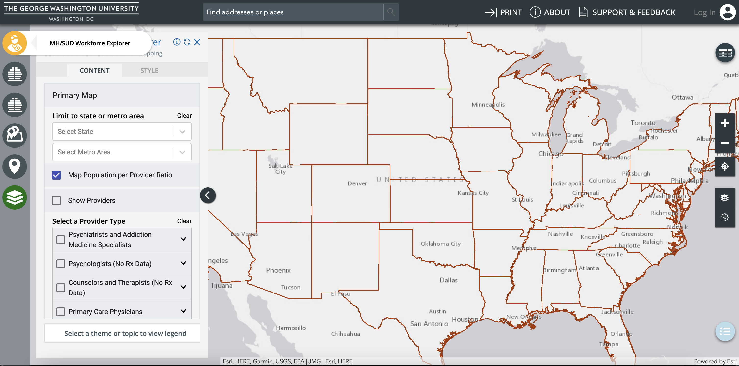
1. Map supply of behavioral health workforce
Select provider type

Slide 19
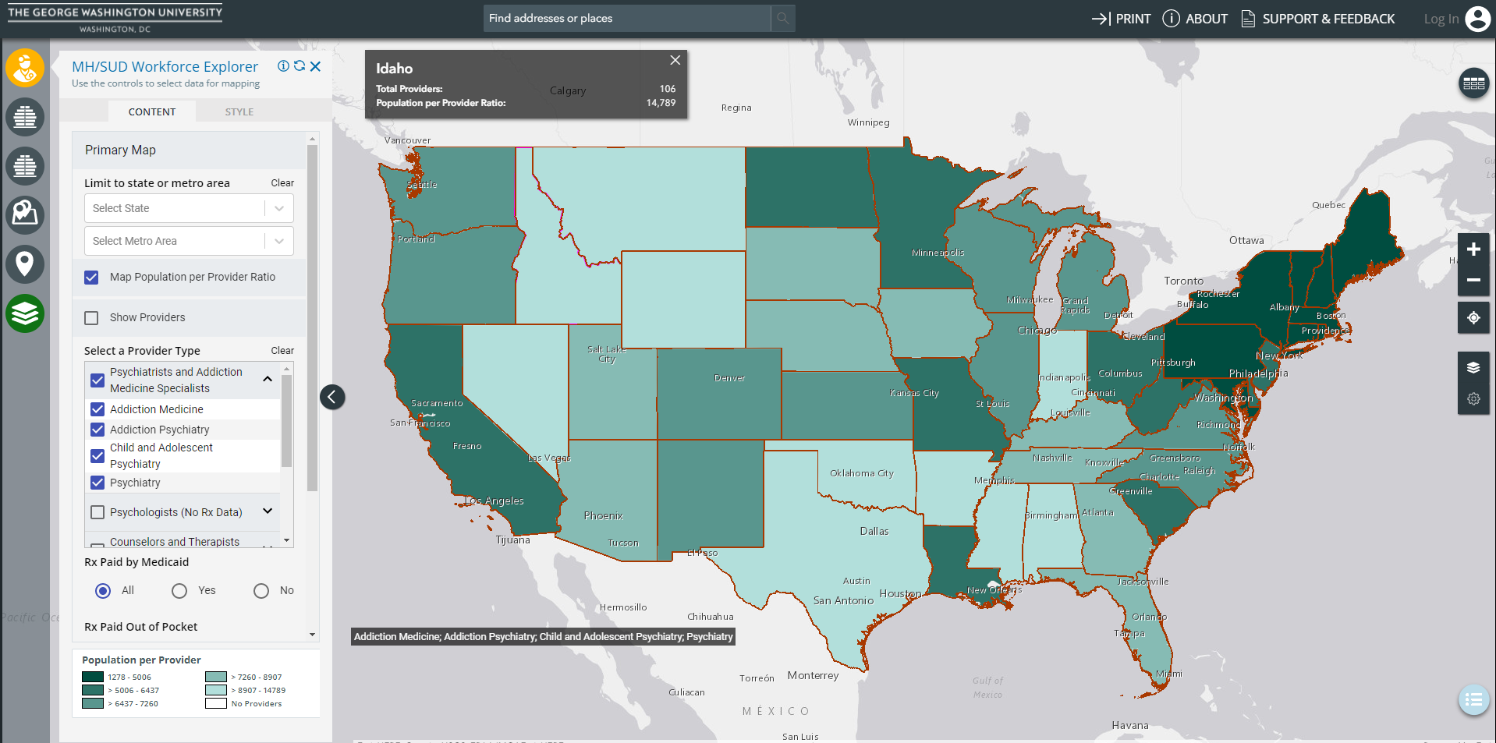

Slide 20
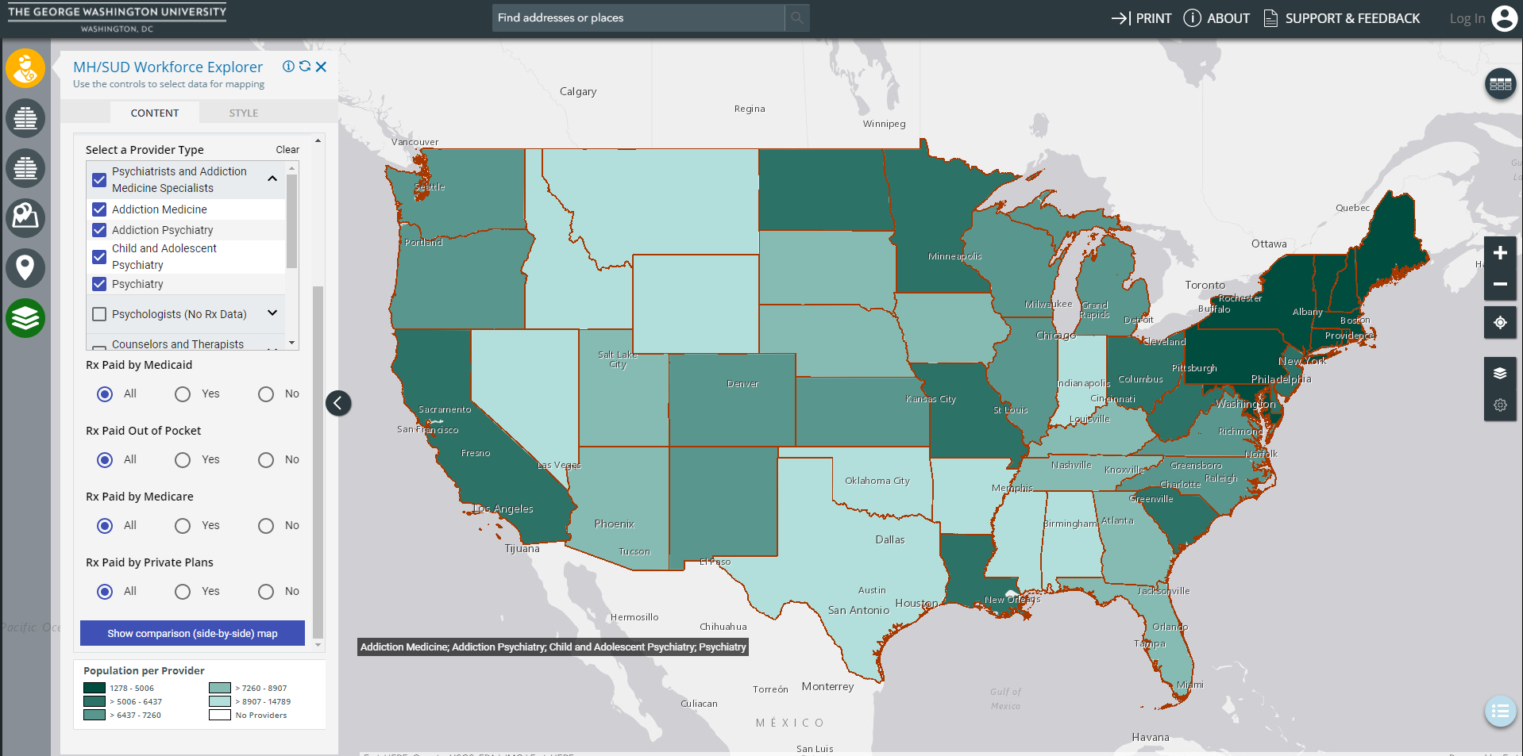
Population to provider quintiles

Slide 21
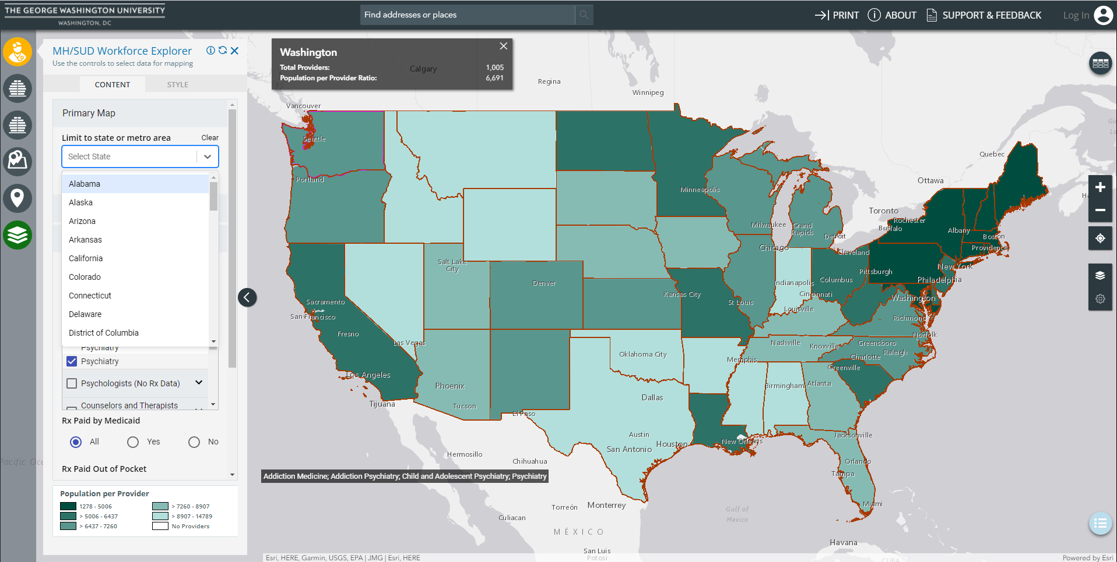
Information box for each state
Choose state for county-level data

Slide 22
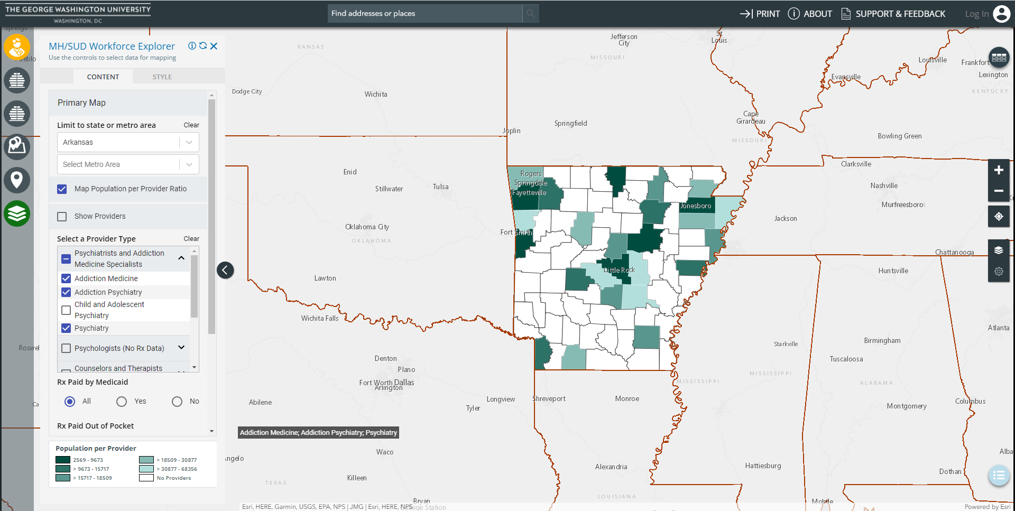
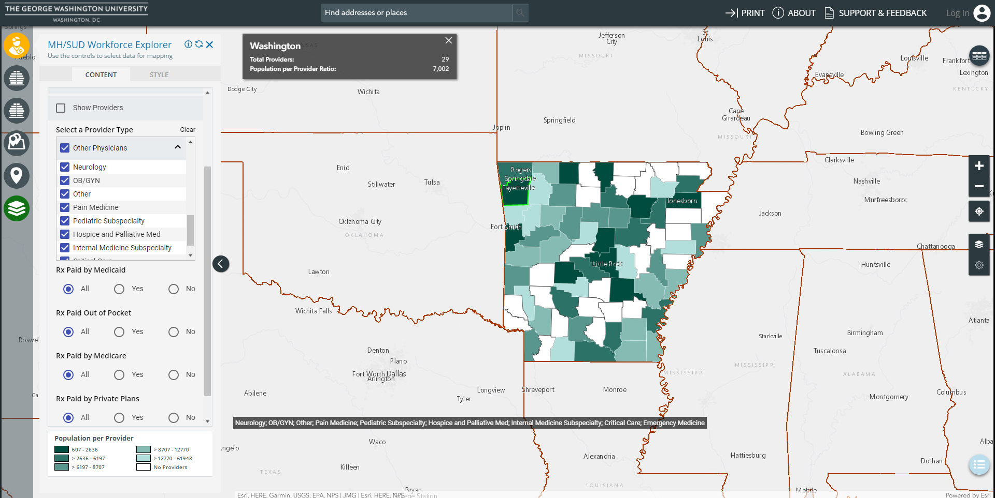
Select and deselect provider types

Slide 23
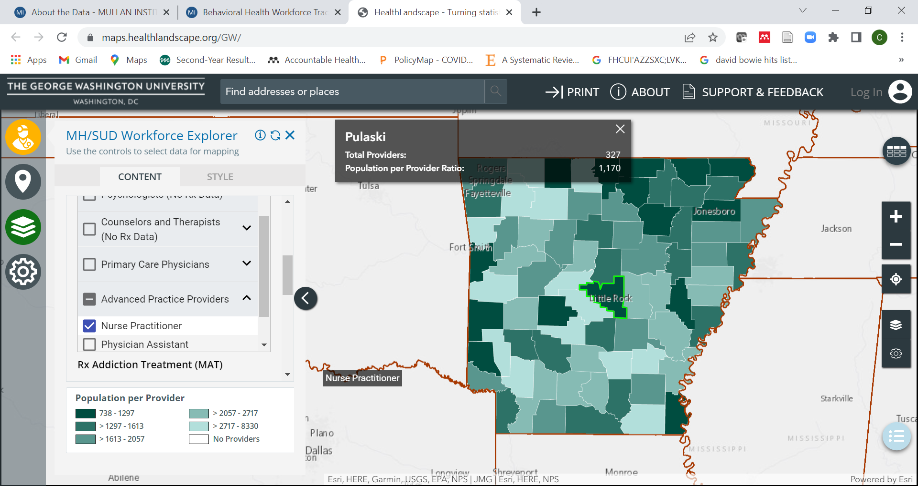
Information box for each county
Disaggregate NPs/PAs

Slide 24
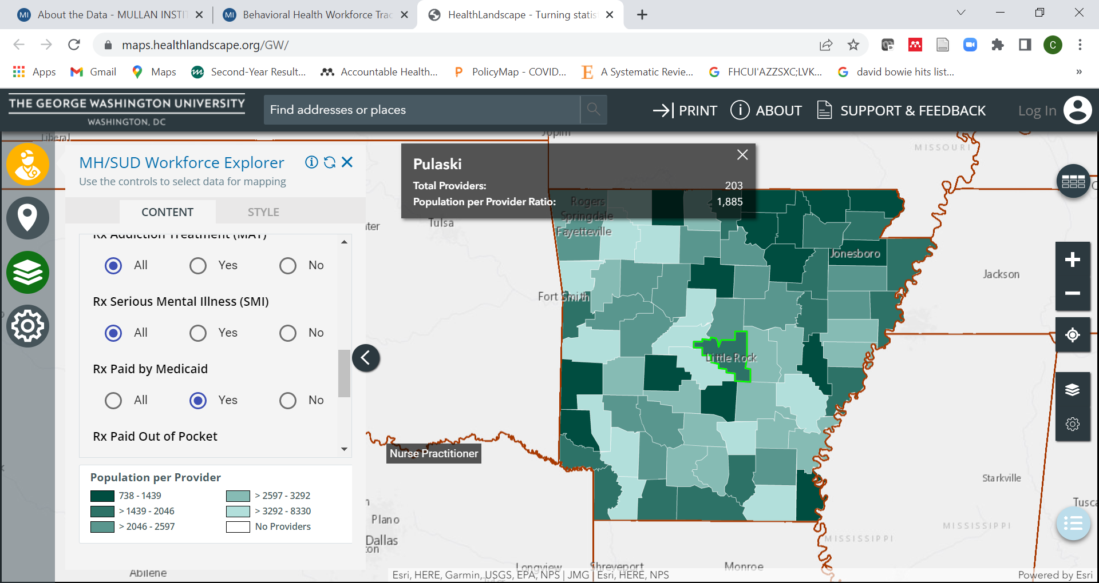
Number of providers dropped
Select payer type

Slide 25
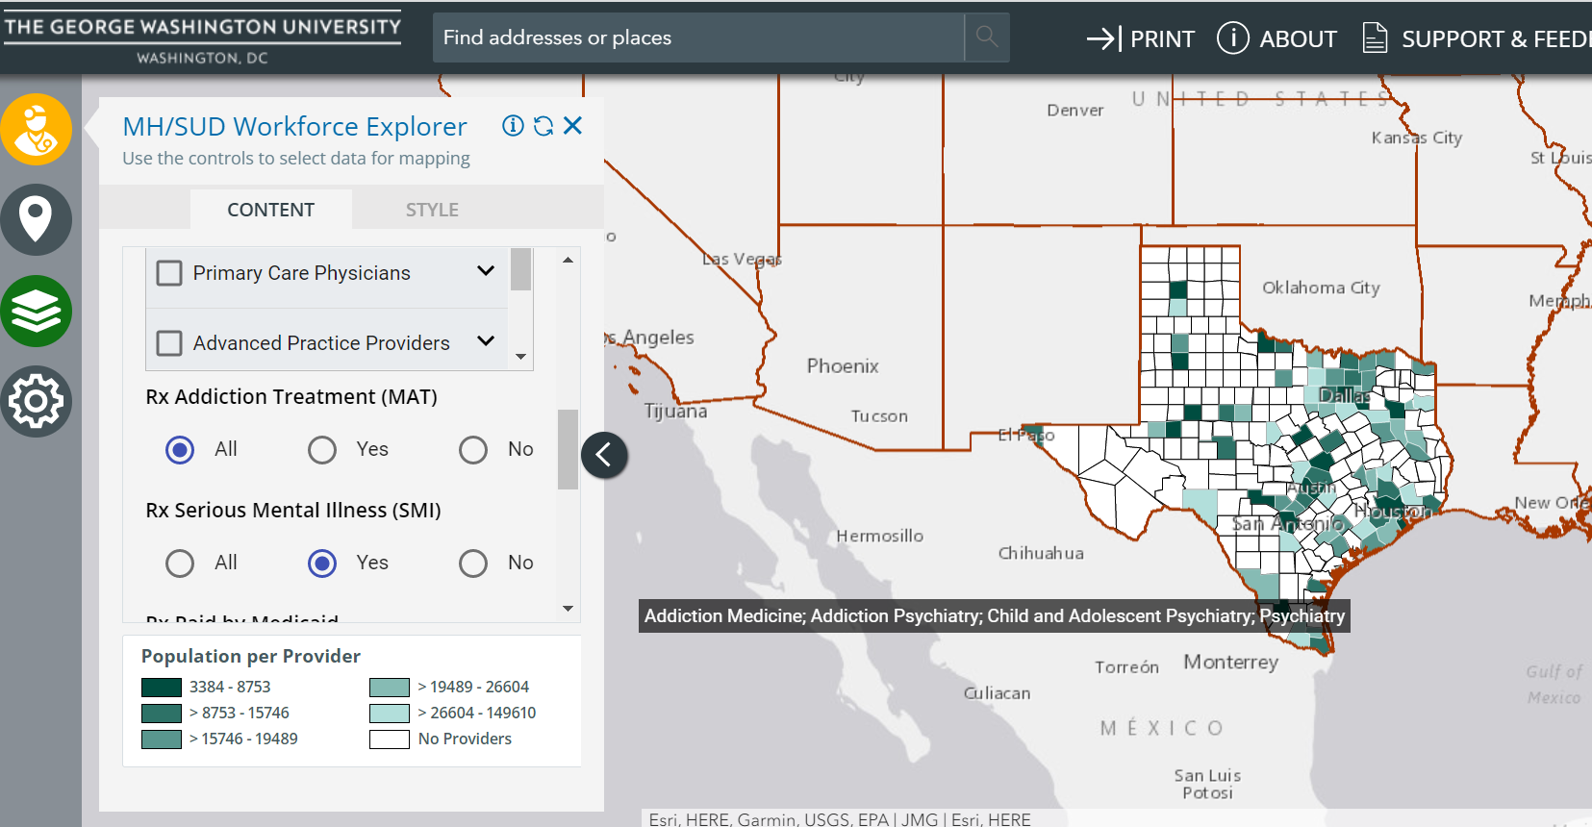
Select Rx Serious Mental Illness (SMI)

Slide 26
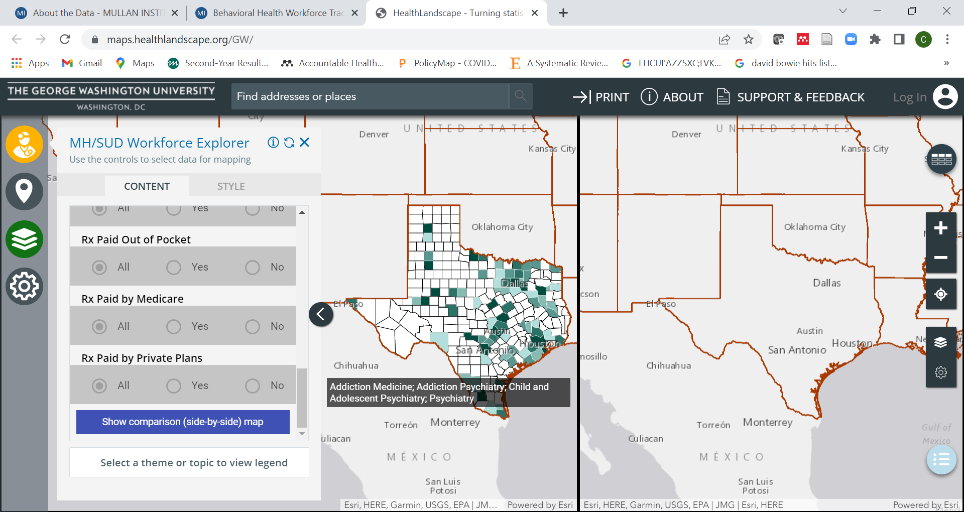
Select Show Comparison (side-by-side) map

Slide 27
Role of Primary Care in Addressing Gaps in SMI Care
Psychiatric and Addiction Specialists Only
Psychiatric and Addiction Specialists and Primary Care Providers

Slide 28
County-Level State Licensure Data
California Psychologists by County
California Counselors and Therapists by County

