Slide 1
2022 Access to Care Survey Results
June 13, 2022

Slide 2
2022 Access to Care: Background About the Survey
Objective: To obtain unique data on barriers to access for mental health and substance use treatment, along with identifying which barriers play a role in looking for and receiving care.
Timeframe: The survey was conducted online by The Harris Poll on behalf of the National Council from April 26-28, 2022, among 2,053 U.S. adults ages 18 and older. Nationally released the results to the public on May, 31 (Mental Health Awareness Month).
Big Picture: More than 4 in 10 U.S. Adults Who Needed Substance Use and Mental Health Care Did Not Get Treatment. Cost, availability, wait times, a lack of diversity and proximity to care all represent significant obstacles for all those seeking care for substance use and mental health challenges – those who were able to access care and those who weren’t.

Slide 3
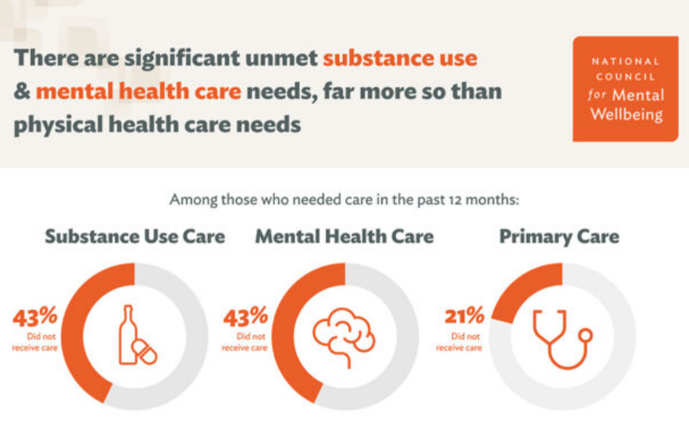
2022 Access to Care Substantial Unmet Need
Notes:
A staggering 43% of U.S. adults who say they needed substance use or mental health care in the past 12 months did not receive that care and identified numerous barriers that stand between them and needed treatment.

Slide 4
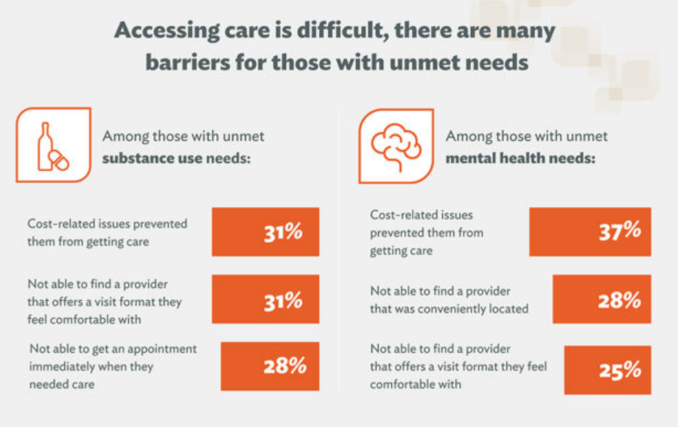
2022 Access to Care Top Barriers to Access

Slide 5
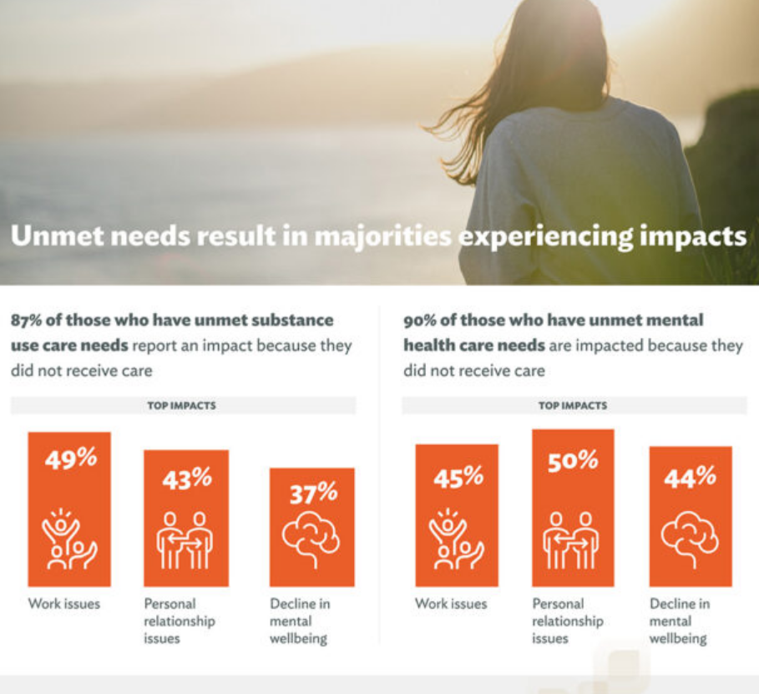
2022 Access to Care Impacts of Barriers to Access

Slide 6
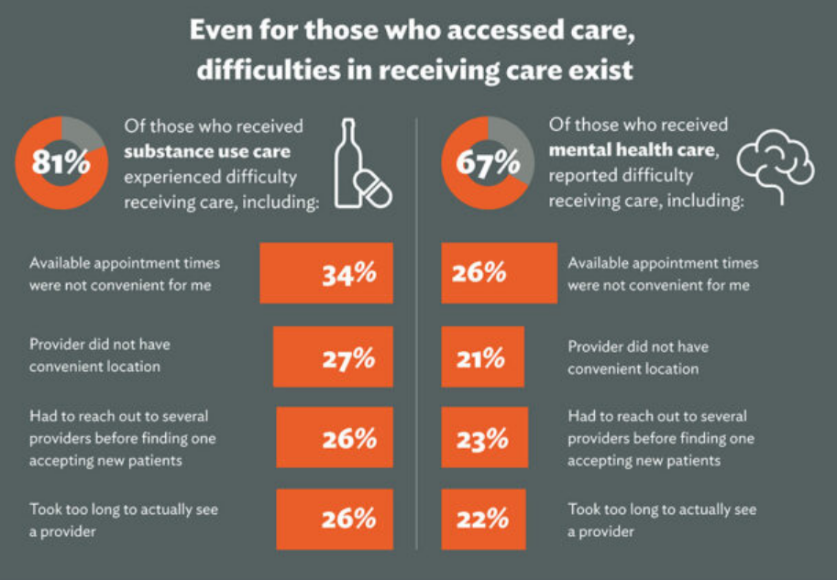
2022 Access to Care People Accessed Care But Still Experienced Barriers

Slide 7
2022 Access to Care Not Easy to Access Care

Slide 8
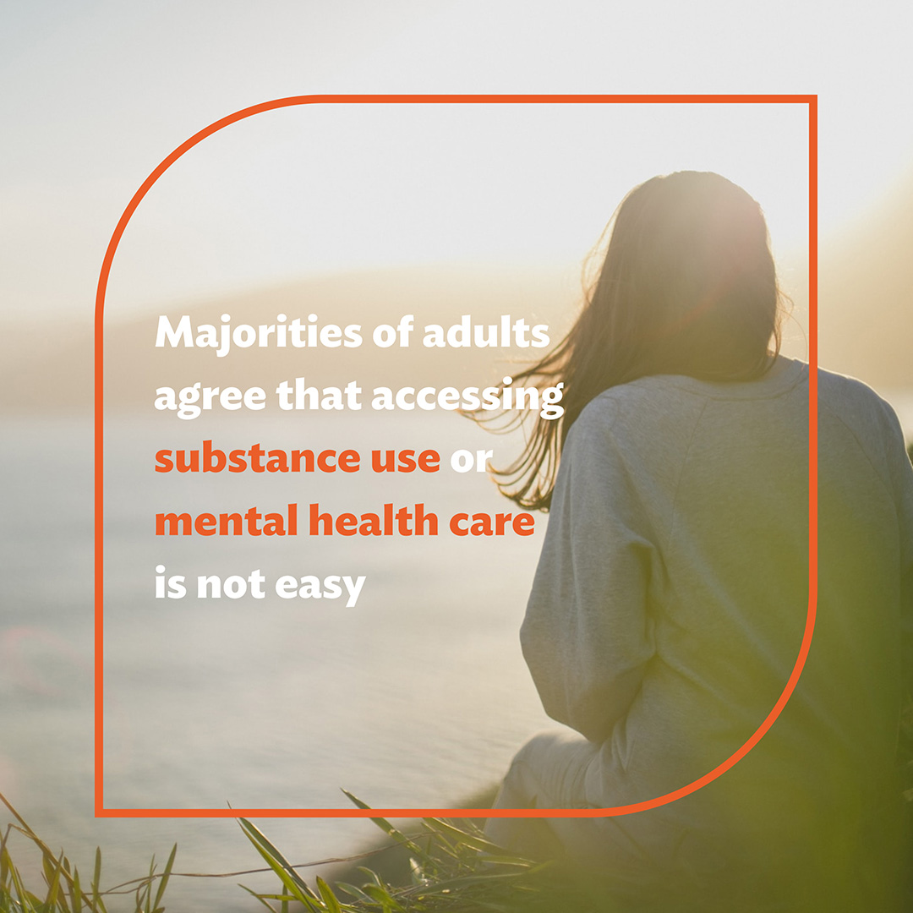
2022 Access to Care: PR Impact Marketing & Communications
*Distribution of our baseline consumer survey generated a lot of pickup. Leveraging the PR Newswire platform, the release was picked up by 214 media outlets with a combined audience of 138 million people.
We had coverage from: AP News, Yahoo! Finance, Mental Health Weekly, HealthDay, The Hill (op-ed)
HealthDay’s story was picked up by 50+ outlets:
U.S. News & World Report
San Francisco Examiner
Omaha World-Herald
United Press International
Madison.com
Data also shared with Members of Congress and their staff, plus the Biden administration, positioning our legislative priorities as solutions for reducing barriers

Slide 9
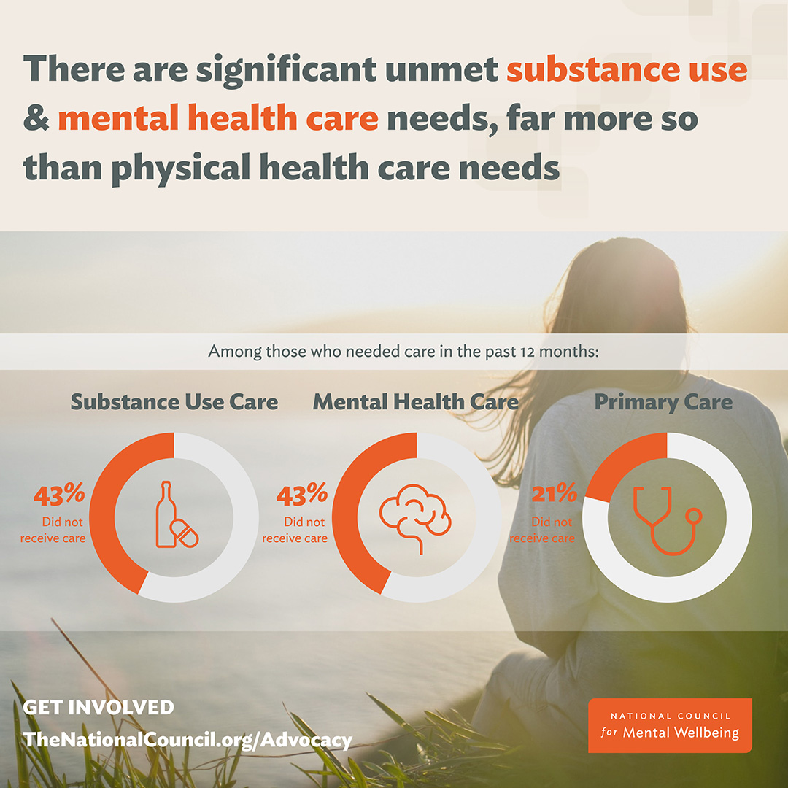
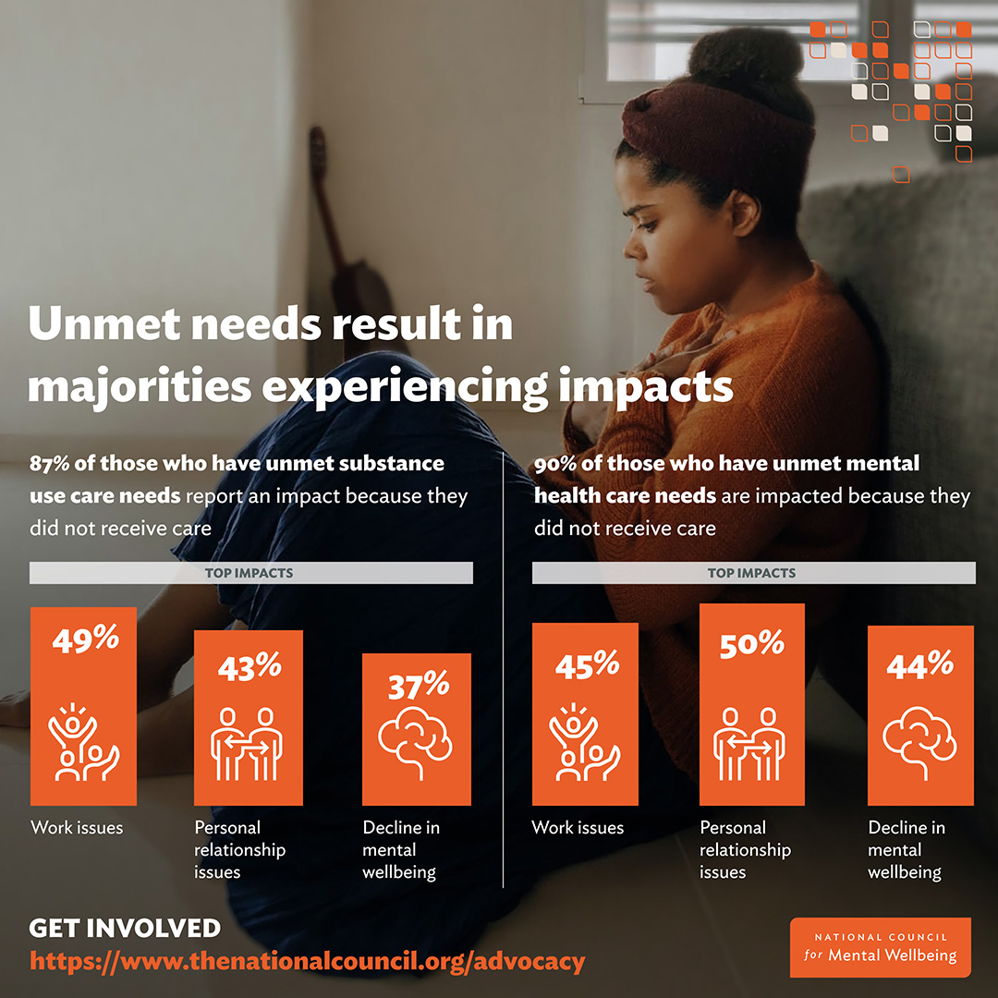
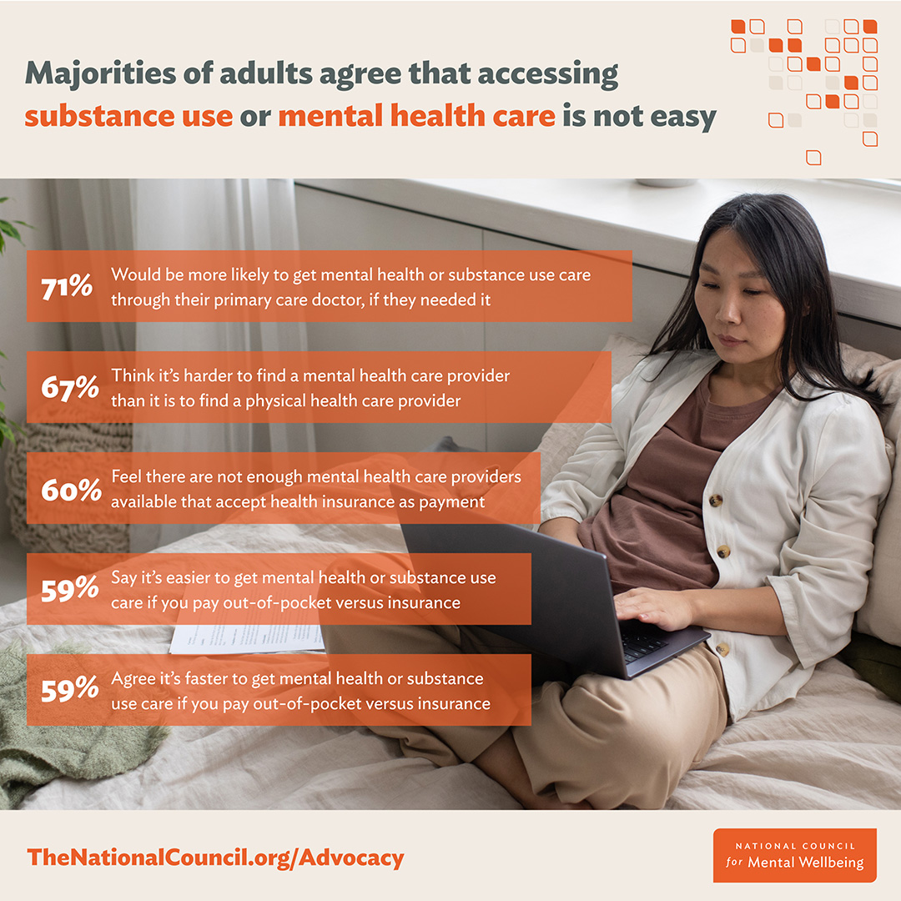
2022 Access to Care: Promotion Marketing & Communications
Maximizing our marketing channels:
PR Newswire
Press release
Shared with members and key audiences
Newsletter coverage
Infographic
Graphics suite
Blog post
Social media

Slide 10
Next Steps Marketing & Communications
Benchmark released in 2022, annual survey will be released each May during Mental Health Awareness documenting the state of access to substance use and mental health care in America.
To establish the National Council as the leading organization addressing barriers to access.
QUESTIONS????

