Slide 1
988 Update
Keisha Pitts, JD
Director, State Policy & Advocacy

Slide 2
Federal Updates
Current Federal Funding
SAMHSA Grant Award for 988 Launch and Operations
$152M total over 2 years
SAMHSA Cooperative Agreements for States and Territories to Build Local 988 Capacity
$105M total over 2 years;
awarded $250K to $14.5M each to all states and territories
CMS Mobile Crisis Intervention State Planning Grants (American Rescue Plan)
$15M total to 20 states
(AL, CA, CO, DE, KY, MA, MD, ME, MO, MT, NC, NM, NV, OK, OR, PA, UT, VT, WI, WV)
Community-Based Mobile Crisis Intervention Services (Medicaid Federal Medical Assistance Percentage)
5 year plan;
85% FMAP for state Medicaid programs

Slide 3
Current Federal Funding
SAMHSA Grant Award for 988 Launch and Operations
Expand workforce and infrastructure for the National Suicide Prevention Lifeline's national backup centers, text/chat centers, Spanish language centers, and specialized services for high-risk populations
Establish local collaborations with 911 (PSAPs) and mobile crisis response stakeholders, building and maintaining national databases of local resources, create and implement protocols for national centers' coordination of community dispatch for local crisis outreach and emergency services
Cooperative Agreements for States and Territories to Build Local 988 Capacity
Improve 988 response by:
Recruiting, hiring and training local 988/Lifeline centers workforce
Unifying 988 response by Lifeline crisis centers across states/territories
Expanding the crisis center staffing and response structure needed for the successful implementation of 988
Expectations for grantees:
Ensure all calls originating in a state/territory first route to a local, regional and/or statewide Lifeline crisis call center
Improve state/territory response rates to meet minimum key performance indicators
Increase state/territory support capacity to meet 988 crisis contact demand

Slide 4
Current Federal Funding (cont.)
CMS Mobile Crisis Intervention State Planning Grants
State Medicaid agencies will:
Assess community needs and develop programs for community crisis intervention services
Integrate community-based mobile crisis intervention services into their Medicaid programs
FMAP for Community-Based Mobile Crisis Intervention Services
Components:
Regional or statewide crisis call centers coordinating in real time
Centrally deployed, multi-disciplinary 24/7 mobile crisis teams
23-hour crisis receiving and stabilization programs
Enhances training, transportation options, and telehealth
Highlights role of CCBHCs in Crisis systems

Slide 5
Introduced Funding
988 Implementation Act of 2022 (H.R.7116)
988 and Parity Assistance Act of 2022 (H.R.7232)
Expands the existing ten state Certified Community Behavioral Health Centers (CCBHC) demonstration to permit any state to participate through Medicaid
Dedicates resources to support local and regional call centers, mobile crisis response teams and crisis centers
Invests in crisis workforce development through training and scholarship opportunities
Provides for technical assistance to states to implement 9-8-8 and capital development grants for crisis programs and call centers
Creates a campaign to ensure Americans know that 9-8-8 is available
Requires all health insurance plans to cover crisis services
Establishes standards for the crisis care continuum
Authorizes grant funding dedicated to states for implementation of mental health and substance use parity enforcement
Dedicates resources for regional and local call centers, mobile crisis response teams and crisis centers
Invests in crisis workforce development through training and scholarship opportunities
Provides for technical assistance to states to implement 9-8-8 and capital development grants for crisis programs and call centers
Creates in an awareness campaign to ensure Americans know that 9-8-8 is available
Establishes standards for the crisis care continuum

Slide 6
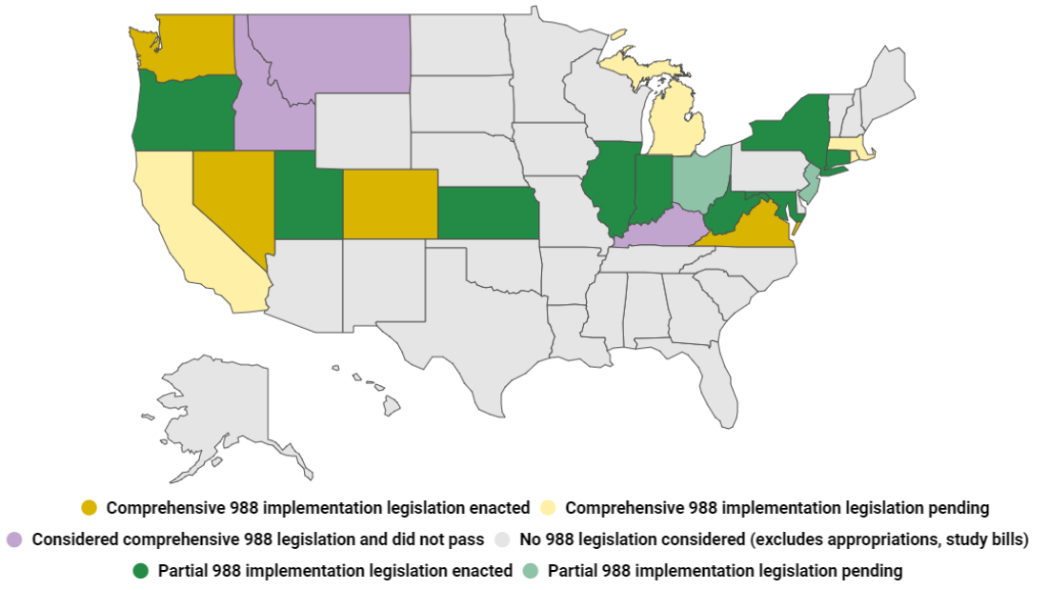
State Updates
12 states passed 988 legislation that included funding (CA, CT, ID, IL, KS, LA, MD, MS, NM, NY, OR, WV)
4 states passed 988 legislation that includes a telecom fee (CO, NV, VA, WA)
5 states passed 988 study or trust fund bills (AL, IN, NE, TX, UT)
7 states have legislation pending (CA, MI, MO, NJ, OH, SC, MA)
7 states had legislation that failed (FL, HI, KY, MN, MT, RI, VT)
13 states have not taken any legislative action to support 988 implementation

Slide 7
How States Can Build CCBHCs into 988 Implementation
1
2
3
CCBHCs as 988 call centers
CCBHCs as providers of crisis support services not provided by 988 call centers
CCBHCs as referral partners for post-crisis or non-urgent needs

Slide 8
CCBHCs participating in the Suicide Prevention Lifeline Network
Guam Behavioral Health and Wellness Center, Tamuing, GU
COMCARE of Sedwick County, Wichita, KS
Mountain Comprehensive Care Center, Prestonburg, KY
Seven Counties Louisville, KY
Macomb County Community Mental Health, Clinton Township, MI
Network 180, Grand Rapids, MI
Compass Health, Clinton MO
Western Montana Mental Health, Missoula, MT
Rutgers University Behavioral Health Care, Piscataway Township, NJ
The Nord Center, Lorain, OH
Family and Children’s Services, Inc., Tulsa, OK
Centerstone of Tennessee, Nashville, TN
Integral Care, Austin, TX
Emergence Health Network, El Paso, TX
MHMR of Tarrant County, Fort Worth, TX
Harris Center, Houston, TX

Slide 9
FCC Geolocation Forum
Calls will be routed based on the caller’s area code
Concern: area codes often do not match the caller’s physical location
Many stakeholders acknowledged that geolocation can save lives
Concerns:
Forced and unwanted interventions
Legal/political risks, ie. trans youth callers parents reported to state agency, undocumented immigrants, etc.
Historical biases affecting specific communities
Options presented:
Disclose that calls will be traced
Caller consent
Only use geolocation on specific calls or limit access to the data
Recommended Next Steps:
Convene multi-stakeholder advisory committee per FCC 988 Geolocation Report recommendation

Slide 10
988 Implementation Guidance Playbooks
SAMHSA, in co-sponsorship with NASMHPD, worked with National Council and other national partners across critical working sectors involved with 988 to develop 988 Implementation Guidance Playbooks.
Available at NASMHPD website:
https://www.nasmhpd.org/content/988-implementation-guidance-playbooks
State, Territories & Tribes(link is external)
Mental Health and Substance Use Disorder Providers(link is external)
Lifeline Contact Centers(link is external)
Public Safety Answering Points (PSAPs)

Slide 11
Thank You

