Slide 1
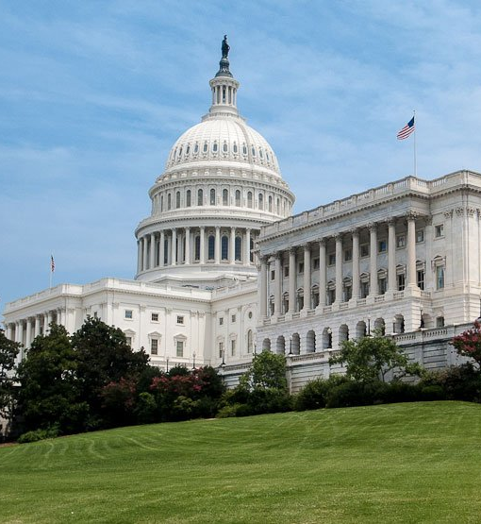
Breakdown of COVID Supplemental Bills
 | CARES Act, March 2020 | COVID Supplemental, December 2020 | FY2021 SAMHSA Appropriations | American Rescue Plan, March 2021 | Deadline for Distribution
SAPT Block Grant | --- | $1.65 billion | $1.858 billion | $1.5 billion | September 2025
Mental Health Block Grant | --- | $1.65 billion (half to providers) | $757 million (5% crisis set-aside) | $1.5 billion | March 2023
CCBHC Expansion Grants | $250 million | $600 million | $250 million | $420 million | Available until expended
Project AWARE | --- | $50 million | $107 million | $30 million | Available until expended
Suicide Prevention | $50 million | $50 million | $66 million (multiple programs) | $20 million (youth suicide) | Available until expended

