Slide 1
CCBHCs: Where We Stand, and What’s Ahead
Association Executives Meeting
June 13, 2022

Slide 2
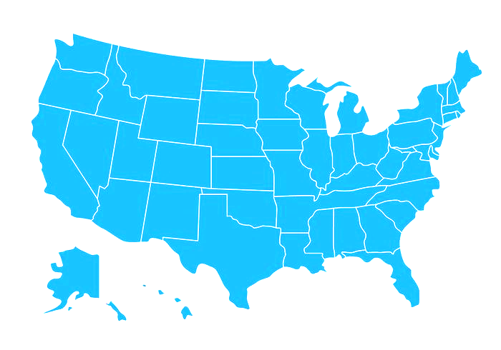
“Unleashing” Change: Our CCBHC Audacious Aim
Our (Updated) Aim: We will transform 500 organizations in the U.S. to CCBHCs by 2025, with sustainable financing through Medicaid.
500
CCBHCs by 2025

Slide 3
Accelerating growth

Slide 4
Federal update
Gun safety package includes CCBHC expansion
Details still emerging
“National expansion of CCBHC model”
Passage not yet guaranteed
Strong bipartisan Senate support gives us hope!
FY2023 appropriations not yet finalized
Requested $560M for CCBHC grants and $3M for TTA Center
The Excellence in Mental Health and Addiction Treatment Act:
Allows any state the option to join the CCBHC Medicaid demo, with enhanced FMAP
Provides grants for new states to plan their implementation
Authorizes SAMHSA CCBHC grants and technical assistance

Slide 5
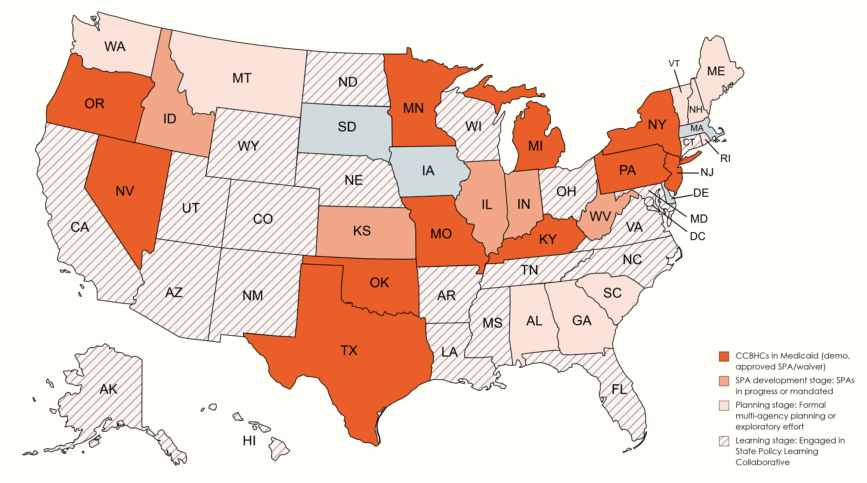
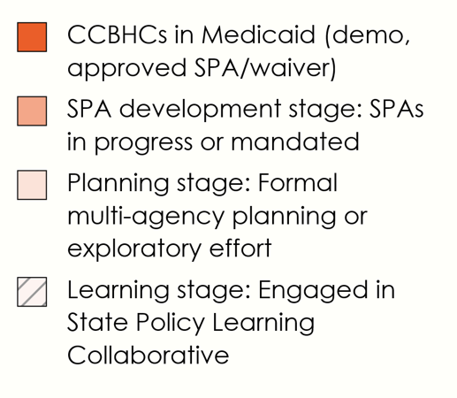
States’ progress toward CCBHCs in Medicaid
National Council providing policy implementation support
Notes:
53 states and territories are involved in the CCBHC State Policy Collaborative with approximately 263 state level government officials.

Slide 6
State policy strategies
Legislative mandate & funding to pursue SPA/waiver
Requires state Medicaid and BH agencies to file a SPA or waiver with CMS for CCBHC implementation
Enacted in: ID, IL, IN, KS, WV
Budget allocation for study & recommendations
Provides funding for state to conduct formal learning or planning process
Enacted in: ME, WA
Funding for “bridge grants” or state-specific CCBHC grants
Supports continuation of CCBHC model by existing grantees near end of grant period, or implementation of CCBHC model by new grantees
Enacted in: IL, NC, WA
Participation in national CCBHC data repository
Statewide data has been crucial in developing state policymaker support
Live in: MO (so far…)

Slide 7
State policy recommendations
Legislative Branch
Tie CCBHC definition to Section 223 of Protecting Access to Medicare Act
Require state alignment with SAMHSA guidance on CCBHC certification criteria
Require state alignment with CMS guidance on CCBHC bundled payment rates/PPS
Connect CCBHCs to 988 implementation and other mental health or SUD efforts in place
Connect with other key partners such as law enforcement, hospital and primary care associations
Executive Branch
Align CCBHC certification criteria with SAMHSA guidelines
Align CCBHC payment with CMS guidelines
Ensure inclusion and buy-in from state Medicaid, mental health and substance use agencies
Leverage CCBHC as a core component of other efforts (e.g., 988, reentry supports, school-based care)
Connect with other key partners such as law enforcement, hospital and primary care associations

Slide 8
Some things for Assoc. Execs to be aware of
131 grantees will expire on Feb. 14, 2023
This cohort was eligible to reapply for current NOFO
We will track how many get renewed grants and keep Assoc. Execs informed
Note that if any of these grantees do NOT win a new grant, we will see the total number of CCBHCs drop for the first time.
100 grantees will expire on Aug. 29, 2023
This cohort will presumably be eligible to reapply during next year’s NOFO
Depending on timing for release of funds, successful applicants could experience up to a 1-month gap in funding
Possible that some grantees will not win renewed grants

Slide 9
Some things to be aware of (cont.)
Some states considering deviations from federal PPS framework
We’re concerned that certain key PPS principles will not be preserved (e.g., cost reports, inclusion of indirect costs, flexibility associated with encounter-based payment)
Could put states in a tough position if demo is expanded
Outcomes data being used to justify implementation may not be applicable
Work needed to engage more CCBHCs in grassroots advocacy
Grassroots critical to our policy success
To date in CY 2022, 19% of CCBHCs have taken action (83 of 430 CCBHCs)
Goal for CY2022: 50%

Slide 10
Annual CCBHC Impact Survey
Together with grassroots action, the annual impact survey is our most effective advocacy tool.
New this year – data on:
Behavioral health/primary care integration
DCO relationships
CCBHCs’ role in their communities’ crisis response systems
Additional detail on health disparities, barriers to health equity
Please help us get the word out when the survey launches soon!
High response rates from states could make it possible for us to provide state-specific data summaries.

Slide 11
Questions & Discussion
Our staff are here to help!
Technical assistance for CCBHC implementation in state Medicaid programs
Advocacy support and strategy brainstorming
Educational sessions for associations, members, and policymakers
Data and informational materials
And more…
Rebecca Farley David: RebeccaD@thenationalcouncil.org
Brett Beckerson: BrettB@thenationalcouncil.org
Monika Witt: MonikaW@thenationalcouncil.org
Mason Lee: MasonL@thenationalcouncil.org

