Slide 1
COVID Update
March 2021

Slide 2
COVID Vaccines Under Approved and Under Development
Phase | One | Two | Three | Limited | Approved
Description | testing safety and dosage | expanded safety trials | large-scale efficacy tests | Vaccines in early or limited use | approved for full use
Participants | Small number | Hundreds | Thousands | In USA – Pfizer, Moderna, J&J | None in USA
Vaccines | 45 | 32 | 23 | 6 | 7
79 Vaccines in human trials total

Slide 3
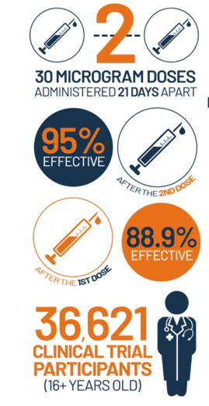
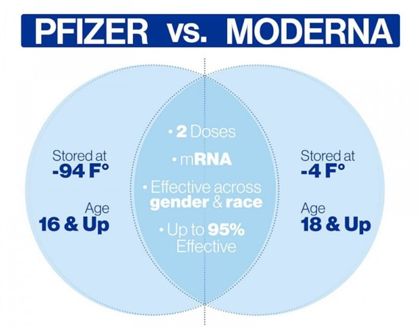
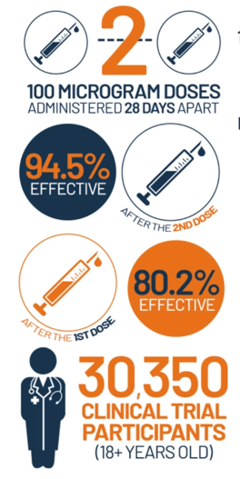
Pfizer/BioNTech and Moderna Vaccines

Slide 4
Johnson and Johnson
genetically modified common cold virus common in chimpanzees produces COVID-19’s spike proteins
Initial efficacy results
USA 72%
Latin America 61%
85% effective in preventing severe cases of Covid
100% effective against hospitalization and death
Stores for 3 months at 36-46 F and 2 years at -4 F
Single dose
FDA granted EUA on Feb 27
But only 16M doses available by end of March
Second Phase 3 trial to observe the effects of two doses of their vaccine, instead of just one began in November
US funding: $1 B upfront for 100M doses if the vaccine is approved.

Slide 5
NovaVax
Grows spike proteins in moth cells (same method used in flu and HPV vaccines) then places the spike proteins onto microscopic particles that trigger an immune response after injection.
Initial efficacy results
Original Virus 96%
South Africa (B.1.351) 49 %
Stores for 3 months at 36-46
Two doses
US Funding: $1.6 B upfront in July, contract for 100M doses if approved
Current phase 3 trials underway
Dec 28 launched 30,000 volunteer trial in US, results expected in March
May be able to supply 110 M doses by June

Slide 6
AstraZeneca and Oxford University
genetically modified common cold virus common in chimpanzees produces COVID-19’s spike proteins
Efficacy
82.4% in UK
Not effective in South African variant (B.1.351)
79% in USA and 100% against severe illness and hospitalization
Lasts 6 months at 36-46 F, Costs only $3-4/dose, easy mass production
2 injections, 12 weeks apart
Mixed Approvals
In Use in over 45 countries including Brazil, UK, Canada, India
On Hold in Norway, Denmark, and parts of EU, due to concerns about blood clots. WHO and EMA found that the risks are no higher in comparison with the background level of these events
US funding: $1.2B upfront for 300M doses, 80M immediately available

Slide 7
Vaccination Progress Report – March 25
Fully Vaccinated 46.4 M (14 %)
At least one dose 85.5 M (26 %)
Average Vaccinations per day 2.49 M
Doses Delivered 169.2 M
Doses used 77%
NM, MA, ND 88%
AR, AL, DC, MS 64-68%
Estimated date to 70% at least partially vaccinated
(herd immunity) – June 20

Slide 8
Risk of Severe Reactions is Very Low
As of January 6 only 21 of the first 1.9 million of Americans to receive the Covid-19 vaccine experienced the severe allergic reaction known as anaphylaxis
17 had known risk factors for severe allergic reactions
20 known to have recovered and no known deaths
By way of comparison
This rate of adverse reactions is 1.1 per 100,000
US Rate of death by motor vehicle crashes is 11.2 per 100,000
CDC advises:
people with a history of drug allergies be observed for 30 minutes
All others be observed for 15 minutes after getting the shot
vaccination sites should have emergency equipment on hand, including epinephrine
Notes:
SEE MY PREVIOUS COMMENT ON LEVELS OF SIDE EFFECTS. I HAVE HEARD THAT IT MAY BE BETTER TO JUST WAIT AND GET COVID IF YOU ARE YOUNG AND HEALTHY THAN RISK HAVING AN ALLERGIC REACTION.

Slide 9
Vaccine Acceptance is Increasing
Month | Got it or will ASAP | Wait and See | Mandated /Never
December | 34%
January | 47% | 31% | 22%
February | 55% | 22% | 22%
Covid has killed about 15 times more Americans than either the flu or vehicle crashes do in a typical year.

Slide 10
COVID Variants Appearing
Britain (.1.1.7) – 30-50% more contagious, currently accounts for 23-30% of new cases,, Approx 60% more deadly than original, vaccines protect well
South Africa (B.1.351) – more contagious, not as susceptible to vaccine induced antibodies but vaccines are still effective
Brazil (B.1.1.28.1 or P.1) – similar to South African variant
Currently USA has no national surveillance program checking virus genomes for new mutations

Slide 11
CDC New Distancing Recommendations
Fully Vaccinated Persons Can:
Visit with other fully vaccinated people indoors without wearing masks or physical distancing
Visit with unvaccinated people from a single household who are at low risk for severe COVID-19 disease indoors without wearing masks or physical distancing
Refrain from quarantine and testing following a known exposure if asymptomatic
Schools can reduce social distance to:
3 foot –
All elementary schools
middle and high schools in low and medium transmission communities
6 foot for middle and high schools in high transmission communities

Slide 12
Persons with SMI or SUD should be CDC Priority Phase 1c
CDC Priority Phase 1c populations
Age 65-75
Age 16-64 with medical condition putting them at high risk of Hospitalization, illness, death
Essential Workers
Increased risk due to SMI or SUD
Persons with SMI die 10-25 yrs younger mostly due to medical illness
Two national studies report increased rates of COVID in persons with MI
Study in NY found persons with schizophrenia had 2-3X COVID mortality
Study of 73M people found persons with SUD at 8.7X risk COVID infection
Study 54,529 people found persons with SUD had 2.3-1.8X risk of hospitalization, ventilator, and mortality

Slide 13
Questions?
Thank You
for being an important part of
the National Council community.

Slide 14
Data Points
Covid has killed about 15 times more Americans than either the flu or vehicle crashes do in a typical year.
Americans under 18 account for only 0.04 percent of Covid deaths.

Slide 15
Fear and Uncertainty are a Challenge
In a recent US-consumer research, 63 percent of respondents are cautious about or unlikely to adopt COVID-19 vaccination.
The “cautious,” who comprise 45 percent of respondents (the largest segment), are those who will wait and see how a vaccine performs in the “real world” before deciding if they will get vaccinated.
Another 18 percent say they are unlikely to vaccinate.
In High Risk Groups only a portion reported being “Interested” in getting vaccinated
Elderly 65%
Black 31%
Hispanic 36%
Earning under $25K/yr 31%
Earning over $100K/yr 60%

Slide 16
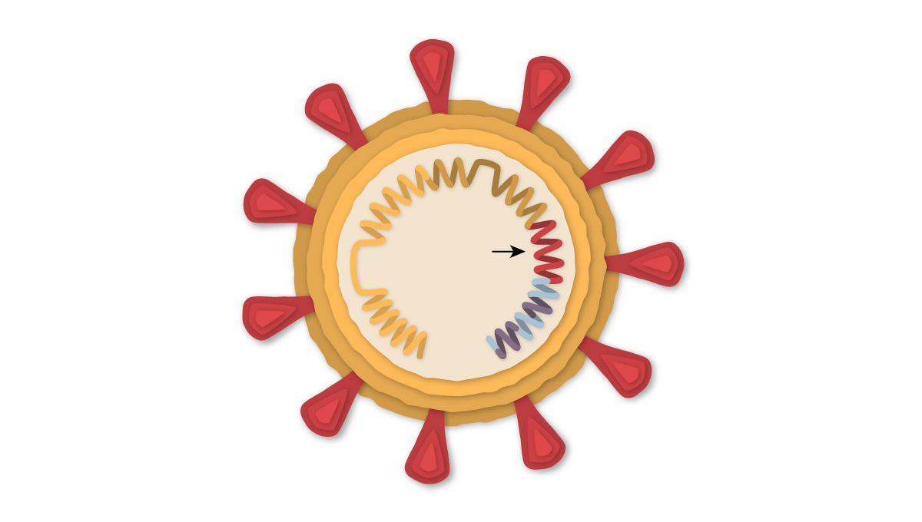
COVID Virus Structure
Spikes
Spike protein gene
Envelope/Membrane

Slide 17
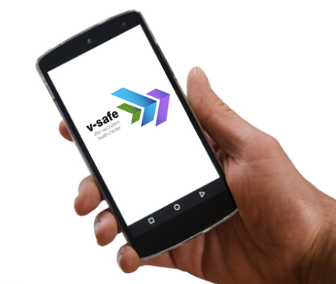
Monitoring Vaccine Safety is a Regular, Ongoing Part of Vaccine Development.
Existing systems and data sources are used to monitor safety of vaccines after they are authorized or licensed, such as:
Vaccine Adverse Event Reporting System (VAERS)
Vaccine Safety Datalink (VSD)
Clinical Immunization Safety Assessment (CISA)
Biologics Effectiveness and Safety System (BEST)
New systems are being developed to monitor vaccine
safety, such as v-safe:
Active surveillance that uses text messaging to initiate
web-based survey monitoring
Any clinically important events reported by a participant
would be sent to VAERS for follow-up
Notes:
Monitoring vaccine safety is a regular, ongoing part of vaccine development and these systems have been in place for decades to ensure the safety of routine vaccines. These systems are complementary and work together to monitor vaccine safety. Components include:
VAERS, which collects and analyzes reports of adverse events that happen after vaccination.
The Vaccine Safety Datalink and the Post-Licensure Rapid Immunization Safety Monitoring System, which are networks of healthcare organizations that actively analyze the healthcare information of millions of people; and
The Clinical Immunization Safety Assessment, or CISA, which is a collaboration between CDC and 7 medical research centers. CISA assists healthcare providers with complex vaccine safety questions and conducts clinical research studies to better understand vaccine safety.
FDA’s Biologics Effectiveness and Safety System, or BEST, which is a system of electronic health record, administrative, and claims-based data for active surveillance and research
These existing data systems can rapidly detect signals for possible vaccine safety problems.
Additional systems and data sources are also being developed to further enhance safety monitoring capabilities. One example is v-safe—an active surveillance system that uses text messaging to initiate web-based survey monitoring.
As you can see, no shortcuts on vaccine safety are taken for these COVID-19 vaccines or any other vaccine.

