Slide 1
SUPPORT for Patients and Communities Act Deep Dive into provisions designed to increase access to treatment

Slide 2
Timeline
Spring 2018: House and Senate begin work on wide-ranging opioid packages
June 22: House passes their bill
Sept. 17: Senate passes their bill
Sept. 25: House and Senate release text of compromise opioid bill
House passes compromise bill on Sept. 28th and Senate concurs on Oct. 3rd

Slide 3
Federal Opioid Legislation
More than 70 unique bills were rolled into H.R. 6 aka the Substance Use–Disorder Prevention that Promotes Opioid Recovery and Treatment for Patients and Communities Act’’ or the ‘‘SUPPORT for Patients and Communities Act’’

Slide 4
Highlights
What’s In?
Telemedicine
SUD Treatment Workforce
Behavioral Health IT
Recovery Housing Best Practices
MAT Prescribing Expansions
Parity for CHIP Plans
Temporary IMD Rule Repeal
Medicare OTP Access
Health Homes for SUDs
SUD Provider - Medicaid Capacity Demo
New and Reauthorized Grants
What’s Not?
Long-term Funding
CCBHC Expansion
42 CFR Part 2 Overhaul

Slide 5
What’s In?

Slide 6
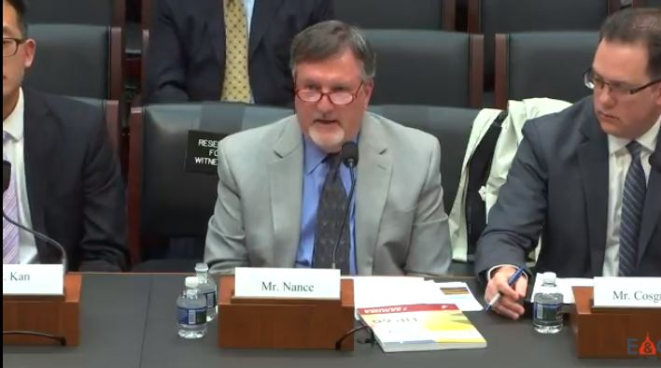
Telemedicine
The Special Registration for Telemedicine Clarification Act*
Requires the DEA to finalize a special registration pathway for additional providers to register with DEA in order to expand access to controlled substances prescribed via telemedicine, including MAT medications and certain psychiatric medications.
National Council member Richard Nance (pictured above) testifies before the House Energy and Commerce Committee on how the bill would expand MAT access in rural and frontier areas of Utah.
*This bill was a direct result of National Council advocacy efforts.

Slide 7
Workforce
The Substance Use Disorder Workforce Loan Repayment Act*
Creates a student loan forgiveness program for students pursuing careers in addiction treatment and recovery.
*This legislation was introduced as a result of education and advocacy by the National Council and the Association for Behavioral Healthcare in Massachusetts.

Slide 8
Workforce (continued)
Improving Access to Mental Health Services Act
Will allow behavioral health National Health Service Corps professionals to work in schools and other community-based settings.

Slide 9
Behavioral Health IT
Improving Access to Behavioral Health Information Technology Act*
Incentivizes behavioral health providers to adopt electronic health records (EHRs) to improve patient care.
*The National Council has been working for passage of this legislation since 2009, when behavioral health providers were left out of a law that created financial incentives for providers and hospitals to implement EHR systems.

Slide 10
Recovery Housing
Ensuring Access to Quality Sober Living Act
The National Council has been a longtime supporter of recovery housing standards. The bill aligns closely with the recommendations of the National Council’s Recovery Housing Toolkit, created in partnership with the National Alliance for Recovery Residences (NARR), to assist states in creating recovery residence certification programs.
Requires SAMHSA to disseminate best practices for operating recovery housing to the states, including model state laws to support their adoption.

Slide 11
MAT Prescribing
TREAT Act/Addiction Treatment Access Improvement Act
Expands access to MAT by:
Eliminating the sunset date for nurse practitioners’ (NPs) and physician assistants’ (PAs) prescribing authority for buprenorphine;
Temporarily expanding buprenorphine prescribing authority to include nurse anesthetists, clinical nurse specialists and nurse midwives;
Permitting a DATA-2000 waivered-practitioner to start immediately treating 100 patients at a time with buprenorphine (in lieu of the initial 30 patient cap) if the practitioner meets certain requirements, and;
Codifies a change that expanded the number of patients that a physician can treat with buprenorphine at any one time to 275 patients, up from 100 patients.
Bottom Line: More MAT prescribers and higher patient caps

Slide 12
Parity for CHIP
CHIP Mental Health Parity Act
Ensures children and pregnant women covered under the Children’s Health Insurance Program (CHIP) can access mental health and substance use disorder services at parity with other health care services.

Slide 13
IMD Rule Repeal
Temporarily repeals the Institutions for Mental Disease (IMD) exclusion, a policy that prohibits Medicaid payment for residential SUD and mental health care in facilities with more than 16 beds.
The repeal would last for five years and cover residential treatment for all substance use disorders for up to 30 days within the previous 12 months. To be eligible to receive federal matching funds, states must meet maintenance of effort and other requirements.
The National Council has long supported and advocated for a change to the IMD restrictions on residential addiction treatment, but was disappointed to see little concurrent investment in community-based services.

Slide 14
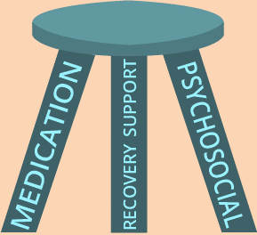
Medicare OTP Access
The bill creates a demonstration project that would allow Medicare beneficiaries to receive MAT and certain wraparound services at an Opioid Treatment Program (OTP), also known as a methadone clinic.
Did you know: Currently, OTPs are not recognized as Medicare providers, meaning that Medicare beneficiaries receiving MAT at OTPs must pay out-of-pocket.

Slide 15
Health Homes for SUDs
Extends the 90% enhanced federal match for Medicaid health home services focused on care coordination for beneficiaries with SUDs from 8 to 10 quarters for states that elect that option.
Also includes a requirement for state Medicaid programs to provide coverage for all forms of medication-assisted treatment, unless the state certifies with HHS that it cannot do so due to provider shortages.

Slide 16
Medicaid SUD Providers Demo
Authorizes new demonstration to help states increase the number of specialty SUD treatment providers participating in Medicaid.
The HHS Secretary would award 18-month planning grants, totaling $50 million, to 10 states, giving preference to those with average or higher SUD prevalence, particularly OUD.
HHS would then select up to 5 states to receive enhanced federal matching funds for Medicaid SUD treatment services during the 36 month waiver implementation.

Slide 17
New Grants
Sec. 3203: Grants for medical schools to develop curricula to help physicians obtain DATA-2000 waivers.
Sec. 6083: Grants for FQHCs and Rural Health Clinics to help offset costs associated with training practitioners to obtain DATA-2000 waivers.
Sec. 7102: Grants for nonprofit community providers or local education entities to provide prevention, treatment and recovery services for children, adolescents and young adults with SUDs.
Sec. 7121: Authorizes a SAMHSA grant program for SUD treatment providers to establish or operate Comprehensive Opioid Recovery Centers (CORCs).
Sec. 7134: Grants for educational agencies to link with mental health systems in order to improve trauma support services and mental health care for students.
Sec. 7183 “Career Act”: Grants for SUD treatment and recovery support providers to help individuals in recovery from a SUD transition to independent living and the workforce. Grantees must have the ability to partner with local employers, community stakeholders government agencies, tribal entities and/or workforce development boards.

Slide 18
Reauthorized Grants
Sec. 7181: Reauthorizes the State Opioid Targeted Response Grant (Opioid STR) and improves flexibility for states in using the grants. Funding is reauthorized at $500 million a year for 2019-2021.
Sec. 7062: Reauthorizes the Residential Treatment for Pregnant and Postpartum Women grant program, which provides funds to providers and other entities to expand comprehensive treatment, prevention and recovery support services for women and their children in residential substance use treatment facilities.
Sec. 8092: Reauthorizes the Dept. of Justice’s Comprehensive Opioid Abuse Program (COAP) through 2023. Program includes grant funding for drug courts and improving linkages between local law enforcement and addiction treatment providers.

Slide 19
What’s Not In?

Slide 20
Sustainable Funding
Few provisions spend any money
Most investment is made via short-term grants, not insurance coverage
Not a comprehensive response to addiction crisis
Does not support the full continuum-of-care for SUDs
Very OUD focused

Slide 21
Certified Community Behavioral Health Clinics (CCBHCs)
Congress missed the opportunity to make a meaningful, long-term investment in our nation’s addiction treatment system by not including the Excellence in Mental Health and Addiction Treatment Expansion Act.
The bill would expand the current eight-state, two-year Certified Community Behavioral Health Clinics (CCBHCs) program.
Active CCBHCs have shown tremendous results in dramatically improving access to opioid addiction treatment and other addiction care.

Slide 22
42 CFR Part 2
The Overdose Prevention and Patient Safety Act
This bill would have aligned 42 CFR Part 2, the regulation governing the privacy of SUD treatment records, with how other health care records are shared through HIPAA.
Bill passed the House, but was not included in final opioid package. Expect to see this bill again next session.

Slide 23
What’s Next?
The National Council and our members will rally Congress to:
Create sustainable investment in behavioral health through Medicaid, Medicare and other insurance options.
Fund all elements of the continuum-of-care.
Appropriate funding for key provisions of the Opioid Package during the 2020 appropriations cycle.

