Slide 1
Political Outlook & National Council Goals 2024 National Council for Mental Wellbeing Reyna Taylor, SVP, Policy and Advocacy

Slide 2
Setting the Stage
Even with the November election, 2024 will be a busy year in Washington.
Expect appropriations pile-ups at the beginning & end of this year.
Lawmakers are facing two government funding deadlines in March 2024 with much work to do on its lagging appropriations process. This could prompt Congress to punt some, if not all, of its pending legislative priorities to the “lame duck” session following the election.
Can Congress clinch a bipartisan tax deal ahead of the TCJA sunset?
The outcome of bipartisan tax talks between the chairs of Ways & Means and Finance could provide lawmakers with momentum ahead of a pivotal year in 2025, when many of the core TCJA provisions will expire absent congressional action.
Several expiring policies and programs will need to be addressed in the new year, including the FAA, National Flood Insurance Program, and more.
Other odds & ends.
Limited floor bandwidth due to the upcoming 2024 election will place pressure on lawmakers to work fast on pending legislative priorities.

Slide 3
Setting the Stage
Status of FY 2024 Appropriations Bills
Bill | House | Senate
Agriculture-FDA | Initial Passage Failed | Passed Senate
Commerce-Justice-Science | Floor Proceedings Postponed | Passed Full Committee
Defense | Passed House | Passed Full Committee
Energy-Water | Passed House | Passed Full Committee
Financial Services & General Government | Considered on the Floor, Proceedings Postponed | Passed Full Committee
Homeland Security | Passed House | Passed Full Committee
Interior-Environment | Considered on the Floor, Proceedings Postponed | Passed Full Committee
Labor-HHS-Education | Considered on the Floor, Proceedings Postponed | Passed Full Committee
Legislative Branch | Considered on the Floor, Proceedings Postponed | Passed Full Committee
MilCon-VA | Passed House | Passed Senate
State-Foreign Ops | Passed House | Passed Full Committee
Transportation-HUD | Considered on the Floor, Proceedings Postponed | Passed Senate
Where Things Stand
Funding for Agriculture-FDA, Energy-Water, Transportation-HUD, and MilCon-VA runs through March 1, 2024, with everything else, including Labor-H, funded through March 8.
Lawmakers must contend with a clause from the bipartisan debt ceiling legislation that institutes a one percent across-the-board funding cut if all 12 spending bills do not pass prior to the end of 2023.
Bipartisan cooperation will be needed to ensure that the government remains funded at levels that are closer to the ones outlined in the Fiscal Responsibility Act.
Where Things Stand

Slide 4
What Can We Get Done in the 118th Congress?

Slide 5
2024 Policy Strategic Goals
Workforce: The National Council seeks to advance legislative and regulatory measures that bolster the mental health and substance use disorder treatment workforce, increase diversity and retention of existing members of the workforce, and ensure consistent accessibility and delivery of quality services and care.
Substance Use Disorder: The National Council advances policies that reinforce substance use disorder services across the continuum of care, and increase recovery supports and overdose prevention.
Access: The National Council advances policies that ensure equitable access to comprehensive mental health and substance use treatment services, prevention, and awareness, including a DEI lens on licensure pass rates and building a diverse workforce.
Certified Community Behavioral Health Clinics (CCBHCs): The National Council works to increase access to comprehensive mental health and substance use disorder treatment services through the advancement of the CCBHC model through legislative and regulatory measures, and adoption of the model at the state level.

Slide 6
What comes next in the 119th?

Slide 7
Federal Policymaking in 2024 and Beyond – Appropriations
Congress faces two critical deadlines in March to prevent a government shutdown, and House Republicans are working on negotiating multiple funding packages to pass all 12 FY24 spending bills within a month.
Congressional leaders recently announced a deal over top line numbers, meaning the total federal spending allowed in fiscal year 2024.
House and Senate Appropriations leaders also recently struck an agreement on funding allocations, otherwise known as 302(b)s, for all 12 bills.
Overall, this is a deal that mostly should hold federal funding level for FY2024, however it leaves open the need to agree to funding levels for each bill as well as continued negotiations over policy riders that Republicans would like to add that are considered poison pills by Democrats and many Senate Republicans.
It is likely that a health care package will be attached to the appropriations bills. Staff are currently negotiating the deal with final decisions excepted soon. This may include:
A SUPPORT Act extension plus additional Medicaid policies. Though a final agreement has not been reached on which policies will be included,
A DSH cut delay
An Extension of the Community Health Centers
More details should emerge in the coming weeks.

Slide 8
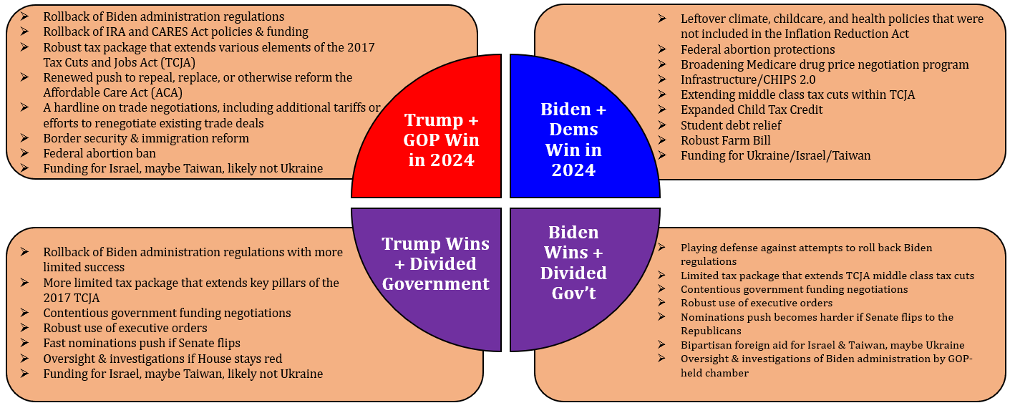
What could Federal Policymaking Look Like After 2024?
Notes:
Reyna

Slide 9
Federal Policymaking in 2024 and Beyond – Behavioral Health
As we look ahead to 2024 and what will happen around mental health and substance use policies, the outstanding policy package most likely to move will be reauthorization of the SUPPORT Act along with any associated new policy riders. Members and staff remain optimistic that the SUPPORT Act will be reauthorized and will include a definition of CCBHCs within Medicaid. Other bipartisan policies, such as the Due Process Continuity of Care Act, may also be included in a larger legislative package.
The timing of this action is tied to other “must pass” bills that are less certain. It is unlikely that the SUPPORT Act will advance outside of a larger legislative package. If a deal comes together to enact a four-agency minibus or extend current funding levels through the end of fiscal year 2024, the SUPPORT Act will likely be included. Should that not happen, reauthorization likely would lag until a broader deal is reached.

Slide 10
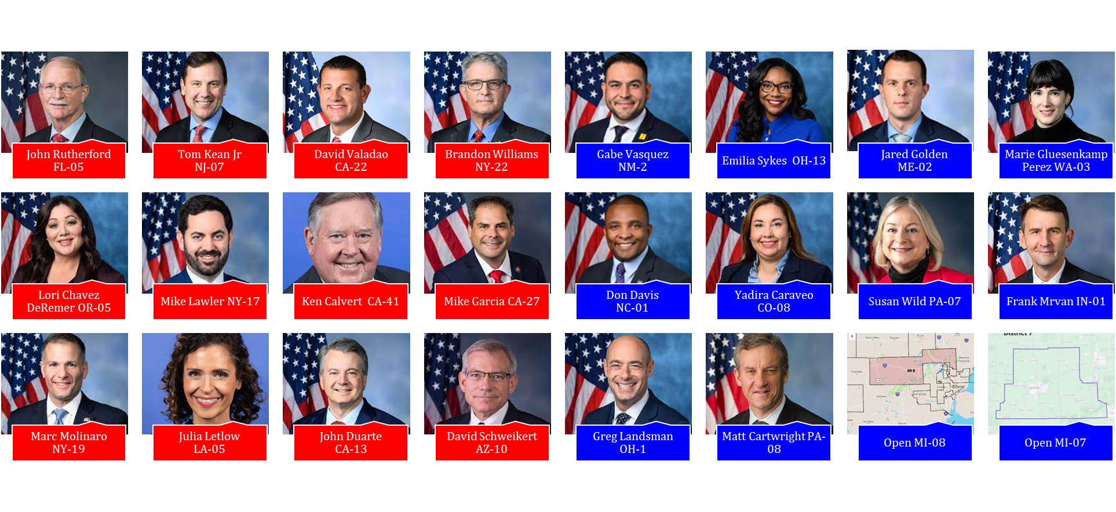
2024 House Races to Watch The outcome of races in these 24 districts could ultimately decide which party controls the House in the 119th Congress.

Slide 11
Cook Political Report House Ratings
Notes:
Telehealth policy changes after the COVID-19 public health emergency | Telehealth.HHS.gov

Slide 12
2024 Senate Map
Several Democratic senators are facing tough re-election bids in both swing states and states won by former President Donald Trump in 2020.
On the other hand, Senate GOP incumbents up this cycle are widely expected to be re-elected, though the DSCC is hopeful to remain competitive in states such as Florida and Texas.
In contrast to the 2022 cycle, NRSC Chair Steve Daines (R-MT) and Leader Mitch McConnell (R-KY) have taken a more active role in candidate recruitment with hopes of toppling some of the more vulnerable Democrats up this cycle.
Notes:
Telehealth policy changes after the COVID-19 public health emergency | Telehealth.HHS.gov

Slide 13
Cook Political Report House Ratings

Slide 14
2024 Primary/General Elections and Congressional Outlook
Presidential Election
The best assumption at this point is that Donald Trump gets the Republican nomination, while Biden will obtain the Democratic nomination. Once that happens, the impact to the Hill and its ability to advance any policies will become even more difficult. That is why it is important for Congress to pass a long-term funding deal quickly.
There are a range of policies that the President could act on, including more support for 988, CCBHCs and behavioral telehealth.
We predict, given the current political environment, that the House will be controlled by Democrats while the Senate will have a Republican majority. The outcome of the presidential election is more difficult to predict at this time.
Of note, the House was reduced to a 2-vote majority on January 22 (following Rep. Bill Johnson’s retirement). New York’s 3rd Congressional district will also hold a special election on February 13. Should that race be won by a Democrat, Republicans will hold a one seat majority until other special elections are held to fill open Republican-leaning seats.

Slide 15
Federal Policymaking in 2024 and Beyond – Caucuses
Senate Mental Health Caucus
The past year saw the creation of the first Senate Mental Health Caucus since 2006. The Caucus aims to improve prevention and early intervention efforts, expand the country's mental health professional workforce, enhance our nation's crisis response services, and increase access to evidence-based mental health treatment and common-sense solutions.
Both co-chairs, Sen. Padilla (D-CA) and Sen. Tillis (R-NC), have seen their lives personally impacted by mental health challenges.
House Mental Health Caucus
Currently chaired by Rep. Napolitano (D-CA), the House Mental Health Caucus serves as a bipartisan forum where Members of Congress and their staff can work together to elevate mental health issues as a national priority by holding informational briefings to pursue common legislative goals and raising awareness of important mental health issues.
Rep. Napolitano is retiring, and we believe she may pass the torch to another Democrat.

Slide 16
Questions
Reyna Taylor, SVP, Policy and Advocacy at ReynaT@thenationalcouncil.org
Or
National Council’s policy team at
Policy@thenationalcouncil.org

