Slide 1
Annual Member Insights Report
Overview

Slide 2
Agenda
Topic | Presenter / Facilitator | Time
Introduction | Chris Coughlin, Director, National Council | ~5 mins
Report Overview | Vikrum Vishnubhakta, Consultant and Principal, Forward Consultants | ~10 mins
An Association Executive Perspective | Heather Jefferis, Executive Director, Oregon Council For Behavioral Health | ~10 mins
Questions and Conclusion | Chris Coughlin, Director, National Council | ~5 mins

Slide 3
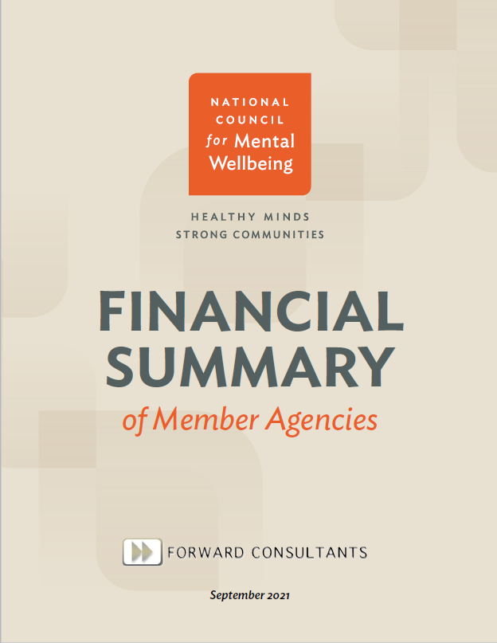
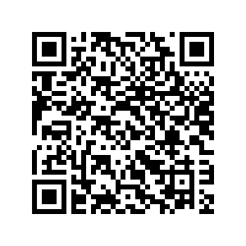
Year 2 Production
Audience Poll:
Who’s downloaded the 2022 report?
Published in 2021
Published in 2022
Access your copy of our report today:
https://bit.ly/3VH1DT3
Free to National Council members

Slide 4
2022 Highlights
Report Objectives
Offer a general profile of National Council member organizations across a three-year period, from 2018–2020.
Segment National Council member organizations into cohorts to enable peer-to-peer comparisons specific to financial health and other descriptive measures.
Provide both internal and external audiences with insights into community mental health and substance use treatment delivery.
What’s New this Year
Three years of financial and descriptive data.
Data segmentation to enable benchmarking.
Spotlight on full market data.
What the Report is Not Intended to do
Provide recommendations on operational decision-making.
Offer concrete financial planning recommendations.

Slide 5
Key Audience Takeaways
For Executive/Leadership/Board of Directors:
Access a peer-to-peer comparison to understand cohort and sector shifts in workforce makeup, benefit provision and financial landscape.
Use these data to help describe the experience of treatment organizations in the field, for multiple audiences.
For Finance Professionals:
Access a peer-to-peer comparison to better understand cohort and sector shifts in revenue and income, income diversification and distribution of costs.
Benchmark your organization’s growth and financial decision-making across multiple years, including the first year of the COVID-19 pandemic.
For External Partners:
Gain financial insights based on geography, rural status and facility type and gain perspective into the distribution of contracted services.

Slide 6
Report Overview
Report Contents
IRS Form 990 Data Inclusion Criteria
Part I. Overview of National Council Membership
Member organizations that submit an IRS Form 990.
We had to manually match the Employer Identification Number (EIN) or Taxpayer Identification Number (TIN) with the IRS Form 990 data.
We then focused only mental health and substance use treatment organizations.
In addition, we included those who had an IRS Form 990 reported across all three years.
This brought the total number of members assessed to 1,021.
Part II. Snapshot of Key Sustainability Measures
Part III. Additional Descriptive and Financial Measures

Slide 7
Segmentation of Member Organizations by Revenue
Cohort | Total Revenue | Number and Percentage of Member Organizations Meeting Criteria
 |  | 2018 | 2019 | 2020
Cohort A | Less than $2.5 Million | 183 (17.9%) | 169 (16.6%) | 168 (16.5%)
Cohort B | Between $2.5 Million and $9.9 Million | 343 (33.6%) | 344 (33.7%) | 327 (32.0%)
Cohort C | Between $10.0 Million and $24.9 Million | 268 (26.2%) | 258 (25.3%) | 266 (26.1%)
Cohort D | $25.0 Million and Above | 227 (22.2%) | 250 (24.5%) | 260 (25.5%)
Note: These cohorts were frequently used for data comparisons.

Slide 8
Sustainability Measure Example: Median Number of Months of Cash on Hand by Revenue Cohort, 2018-2020
Part II. Substantiality Measures
Highlights number of employees, total revenue, net income, current ratio, months of cash on hand, program efficiency and personnel expense ratio across various segmentations.
This measure assesses how many months an organization could continue to operate if they did not receive any more revenue. Ideally, an organization would have at least six months of cash on hand, but ~ 3 months is more common in nonprofit space.

Slide 9
Data Segmentation Example: Median Net Income Reported by Rural-based Member Organizations (by Combined HRSA Region), 2018-2020
Part II. Substantiality Measures
Highlights number of employees, total revenue, net income, current ratio, months of cash on hand, program efficiency and personnel expense ratio across various segmentations.
Of the 557 member organizations designated as located in a rural area, 332 (57.8%) were matched in this analysis.
West: n=81 │ Midwest: n=134 │ Northeast: n=43 │ Mid-Atlantic: n=37 │ South: n=27

Slide 10
Income-Related Example: Median Net Margin of Program Service Income of Member Organizations by Revenue Cohorts, 2018-2020
Part III. Additional Descriptive and Financial Measures
Four cohorts were developed based on total revenue to assist member organizations in making comparisons across income statement and balance sheet metrics.
Cohort | 2018 | 2019 | 2020
Cohort A | 0.0% | 0.0% | 0.0%
Cohort B | -3.8% | -3.1% | -3.8%
Cohort C | -11.2% | -10.4% | -12.4%
Cohort D | -7.9% | -7.3% | -9.3%
Calculation: Net program service income / Program service revenue
Interpretation: For example, in 2020, the median member organization in Cohort C reported a loss of $0.12 for every $1.00 reported as program service revenue.

Slide 11
Staffing-Related Example: Most Common Roles of Contractors Hired by Member Organizations, 2020
Part III. Additional Descriptive and Financial Measures
Four cohorts were developed based on total revenue to assist member organizations in making comparisons across income statement and balance sheet metrics.
Role of Contractor | Member Organizations: n (%)
Healthcare or Clinical Services (Physicians, Nurses) | 332 (16.0%)
Mental and Behavioral Health-Related Services | 264 (12.8%)
Architect, Building and Construction Services | 185 (8.9%)
Information Technology | 177 (8.6%)
General Consultant, Contractor, Professional Services | 157 (7.6%)
Cleaning, Janitorial and Maintenance Services | 131 (6.3%)
Employee Staffing | 105 (5.1%)
Leasing and Property Management | 78 (3.8%)
Accounting and Auditing Services | 66 (3.2%)
Food and Catering-Related Services | 63 (3.0%)
Computer and Software Services | 51 (2.5%)
Attorney and Legal Services | 48 (2.3%)
Security | 39 (1.9%)
Bill Processing and Payroll Services | 36 (1.7%)
Child Care and Day Care | 24 (1.2%)
Other | 313 (15.1%)

Slide 12
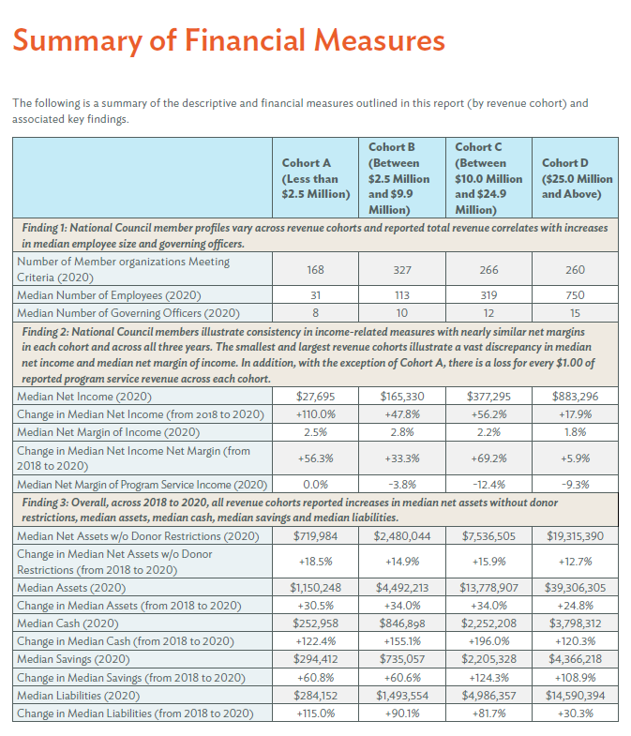
Summary of Findings
Finding 1: National Council member profiles vary across revenue cohorts and reported total revenue correlates with increases in median employee size and governing officers.
Finding 2: National Council members illustrate consistency in income-related measures with nearly similar net margins in each cohort and across all three years.
Finding 3: Overall, across 2018 to 2020, all revenue cohorts reported increases in median net assets without donor restrictions, median assets, median cash, median savings and median liabilities.

Slide 13
An Association Executive Perspective
Heather Jefferis
Executive Director
Oregon Council For Behavioral Health

Slide 14
Questions?

Slide 15
National Council Members: Curious how you fare on key financial measures vs. other mental health and substance use treatment organizations?
Non-members: Want to gain financial insight into our members based on geography, rural status, facility type and contracted services?
Our 2022 Annual Member Insights Report – free to National Council members and $150 for non-members – can help! It offers:
Three years of financial and descriptive data
Data segmentation to enable benchmarking
Spotlight on market data
Download our new and enhanced report today!
https://bit.ly/3VH1DT3

