Slide 1
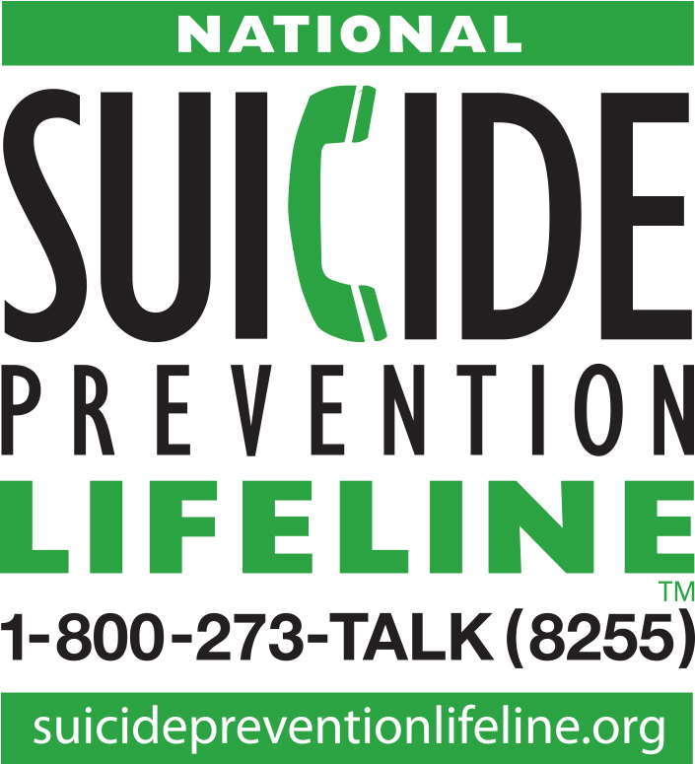
The National Suicide Prevention Lifeline:
A National Safety Net and 9-8-8
October 6, 2020
National Council for Behavioral Health State Association Executives Meeting
John Draper, Executive Director
Laura Evans, Program Manager for State and National Policy
Matt Taylor, Director of Network Development

Slide 2
Disclaimer
The views, opinions, and content expressed in this presentation do not necessarily reflect the views, opinions, or policies of the Center for Mental Health Services, the Substance Abuse and Mental Health Services Administration (SAMHSA), or the U.S. Department of Health and Human Services.

Slide 3
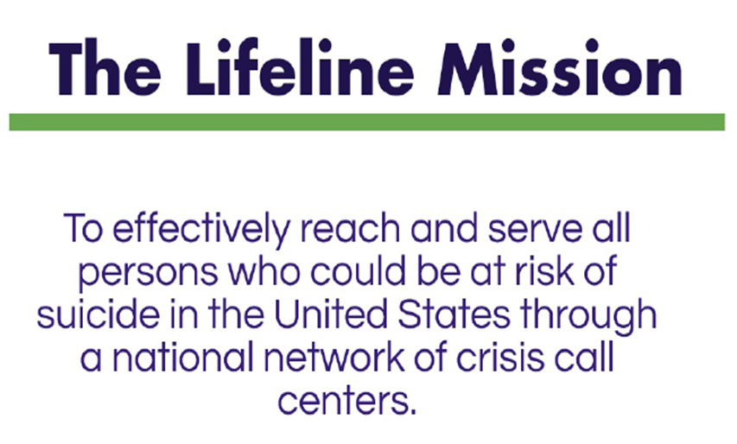
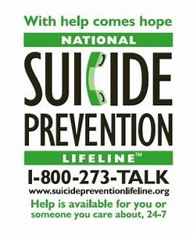
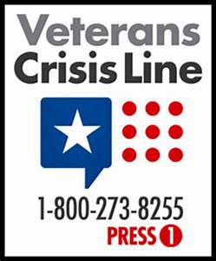
Lifeline: The Nation’s Public Mental Health Safety Net
Notes:
Ok
[dk] conform style

Slide 4
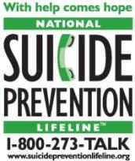
Lifeline: The National Portal for Local Services
The Lifeline is a network of independently operated, independently funded local and state call centers (180+) across all 50 states.
Callers who press #1 are routed to Veterans Crisis Line. Callers who press #2 are routed into Lifeline’s Spanish language network.
All other calls are routed to the nearest center, local center… or into our national backup network if the local center can’t answer.
Why Local Centers?
Suicide prevention actions rooted in communities (training, education)
Linkages to local resources (including crisis and emergency services)
Notes:
ALSO NOT 2.2M CALLS ANSWERED, ABOUT 25% PRESENT WITH SUICIDAL ISSUES
SAMHSA, NASMHPD AT LAUNCHING, VA SINCE 2007

Slide 5
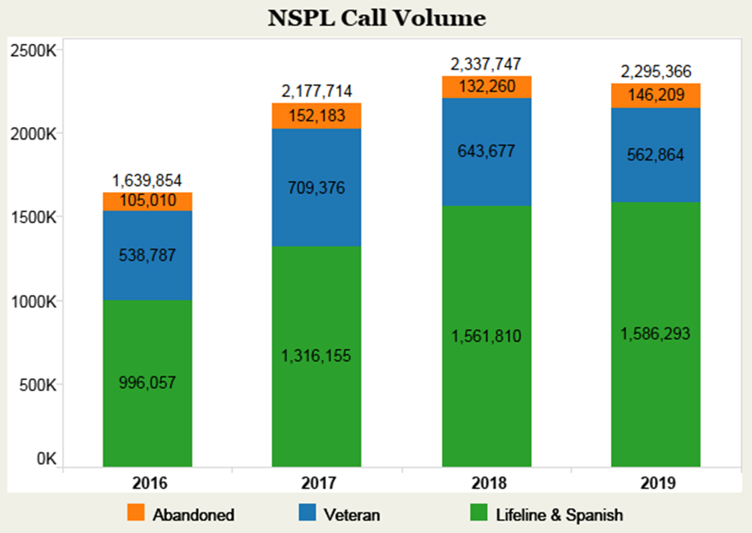
Lifeline Call Volume: 2016 - 2019

Slide 6
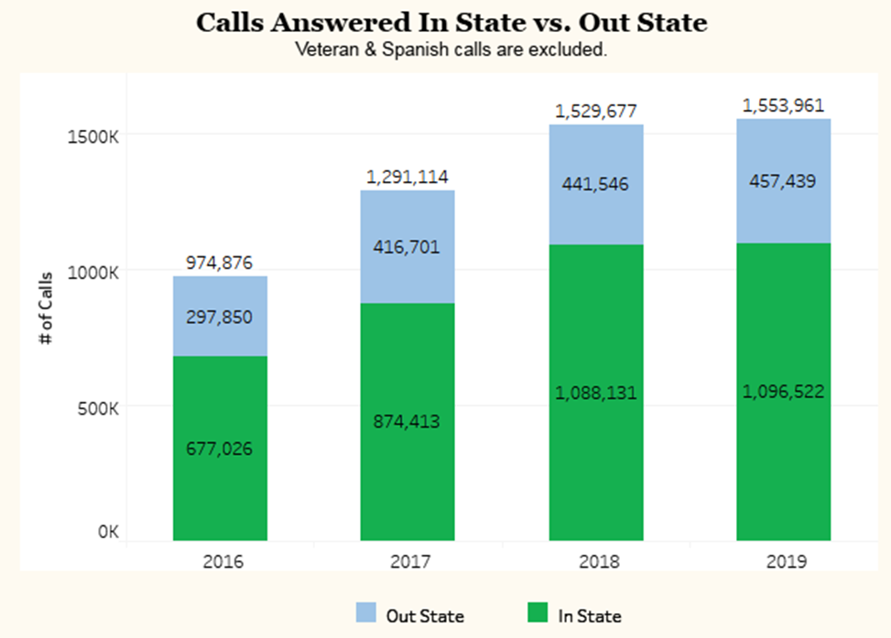
Calls Answered by Year: In-State vs. Out-of-State

Slide 7
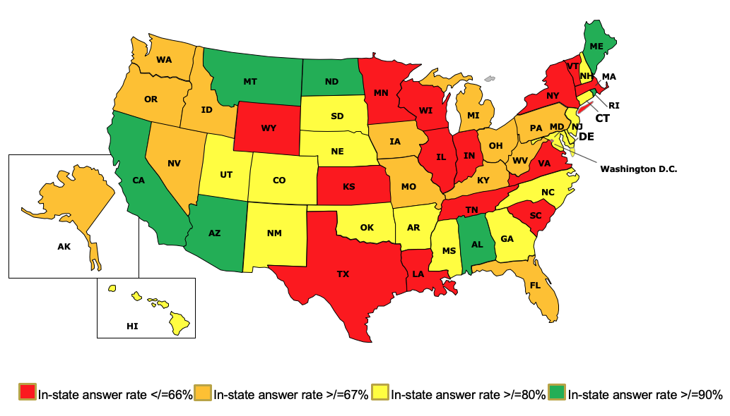
Boosting in-state answer rates for Lifeline calls is key now, and especially for 9-8-8
Lifeline In-State Answer Rates June 2020

Slide 8
Lifeline Evaluation Findings:
First Studies (2003-2004)
Access point for acutely suicidal:
About 25% of Lifeline callers present with suicidal thoughts, plans, attempts (Gould, 2009)
More than 50% of 1080 suicidal callers had plan, over 8% with an attempt in progress; nearly 60% had past suicide attempts (Gould et al 2007)
Effective in reducing distress & suicidality
significant reductions in confusion, anger, anxiety, helplessness, hopelessness and suicidality at end of call & 3 wks later
12% of suicidal callers report call prevented them from killing self

Slide 9
Lifeline Best Practices:
They’re Working!
Federal evaluations since 2005 have shown:
Lifeline-sponsored trainings for centers (ASIST) significantly reduce risk in callers more than centers not receiving training
Lifeline Policies effective in reducing imminent risk through less invasive means (76% highest risk de-escalated collaboratively)
Lifeline follow-up calls to persons at risk work; 80% say calls helped keep them safe, with half saying “it’s the reason I’m alive”
2014 RAND Study: Callers to CA Lifeline crisis centers more likely to be assessed for suicide and report less distress by end of the call than non-Lifeline centers

Slide 10
The future: a new, national 3-digit number (988)
“The availability of a three digit number for mental health and suicide prevention could be a transformative step forward in improving national crisis intervention and suicide prevention efforts; if the launch of the new number is accompanied by efforts to develop a more coordinated crisis system with greater capacity and access to sophisticated data and technology.” – SAMHSA
Easier to remember than a 10-digit number
Sends the message that mental health crises and suicide prevention are of equivalent importance to medical emergencies
Reduces stigma surrounding suicide and mental health issues

Slide 11
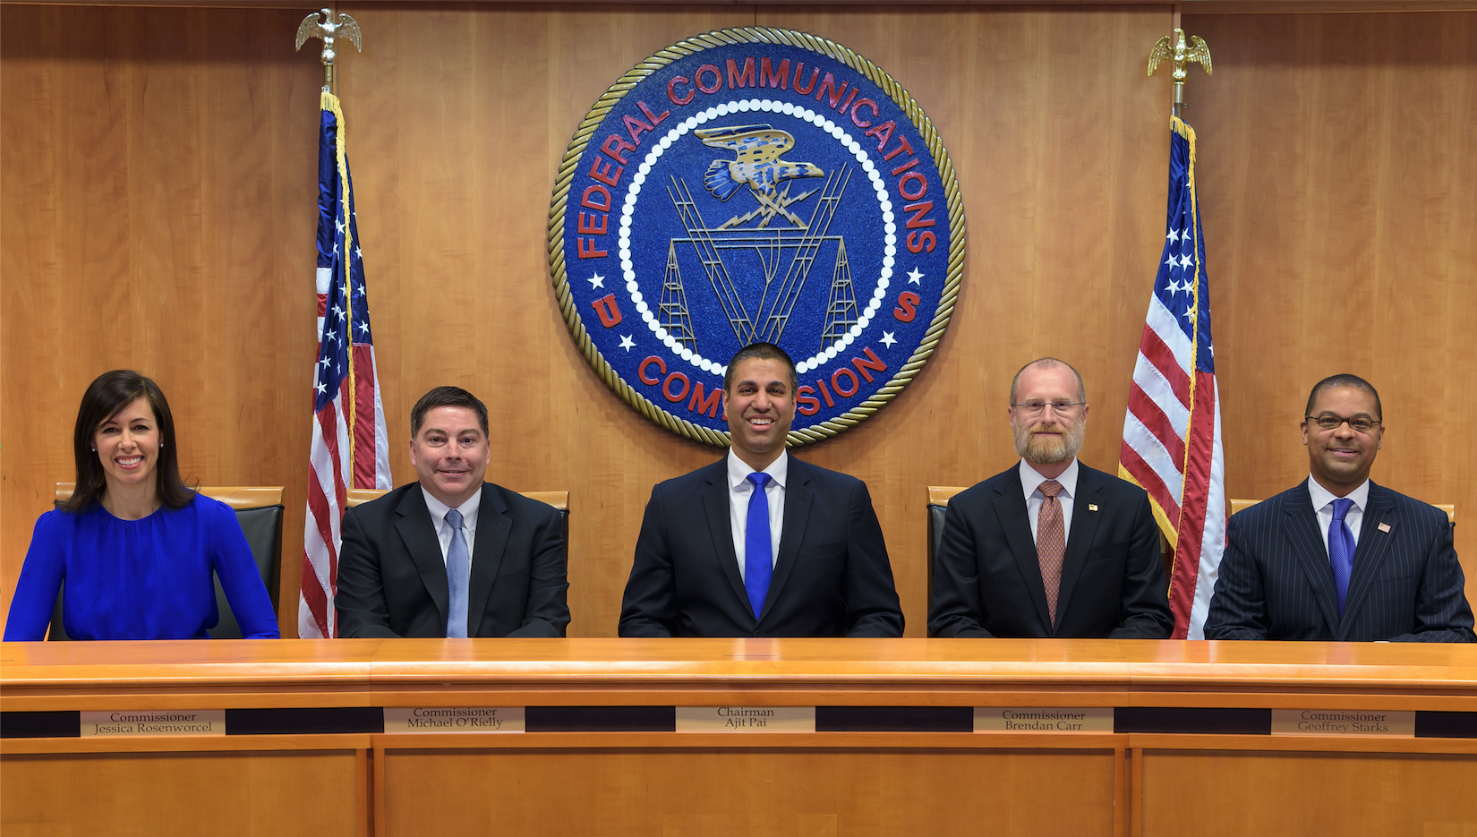
The FCC Decision on 988 (7-16 2020)
“…This Order requires voice service providers to transmit 988 calls
To the National Suicide Prevention Lifeline by July 16,2022—the earliest
Technically-feasible date for nationwide implementation of 988.”
Chairman Ajit Pai, July 16, 2020

Slide 12
9-8-8 Legislation in Congress
The National Suicide Hotline Designation Act of 2020 passed unanimously in the Senate in May 2020 and in the House September 21
As of of
10-6-20 the Act awaits President Trump’s signature.
Designates 988 for a national suicide prevention and mental health crisis hotline (Lifeline and the VCL)
Requires SAMHSHA/VA to report to Congress on infrastructure needs within six months of the bill enactment.
Also requires SAMHSA to submit a plan to provide network trainings and access to specialized services for populations such as LBGTQ youth; minorities; rural individuals & other high risk pops.
Allows States to levy fees for local 988 related services on wireless/IP Carrier bills, including crisis outreach, stabilization, mental health services responding to 988 contacts
Requires FCC to report to Congress on 1) the collection and distribution of carrier-fee funds, and 2) the feasibility and cost of geolocation services

Slide 13
Thanks for all you do to create safe and supportive communities. Let’s partner together to increase local call center capacity for your neighbors and loved ones dialing the Lifeline.
The National Suicide Prevention Lifeline
https://suicidepreventionlifeline.org/our-network/

