Slide 1
Identifying Opportunities: Mental Health First Aid and Mental Health Awareness Training Grants
January 8, 2021

Slide 2
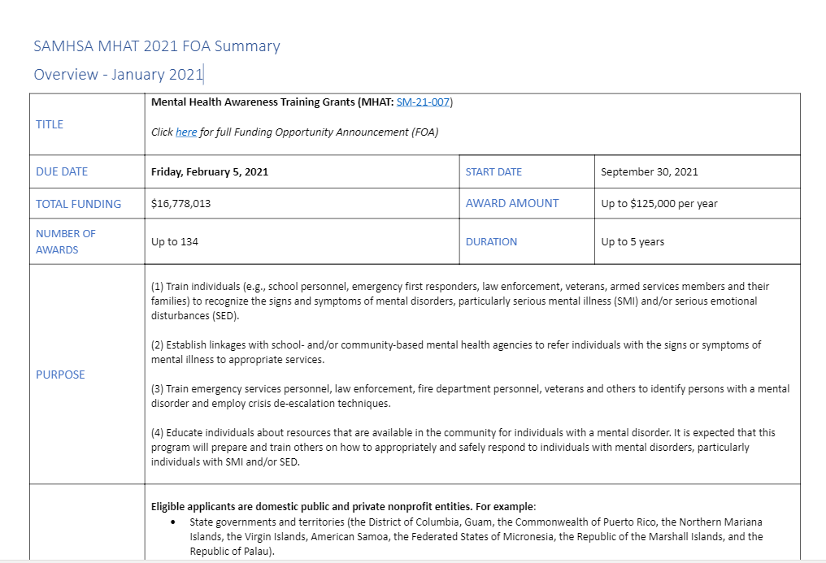
Mental Health Awareness Grant (MHAT:SM-21-007)
The MHAT grant will help expand MHFA training for individuals in school settings, emergency first responders, law enforcement, veterans, armed service members and their families.
*Please note: If you are considering submitting an application, be sure to complete the registration process.
Due: February 5, 2021
Mental Health First Aid: SAMHSA Mental Health Training FOA Summary
Notes:
More details about funding eligibility and requirements can be found on our web page, links will be shared later in this presentation.

Slide 3
Upcoming National Council Webinar:
Introduction
Mental Health Awareness Training Grant
Resources and Q&A
Mental Health First Aid Overview
Mental Health First Aid Implementation Options
Join us Friday, January 8, from 3-4 p.m. (ET)
Notes:
The purpose of this webinar is to provide an overview of the Mental Health Awareness Training Grant (MHAT: SM-21-007) grant opportunity, introduce Mental Health First Aid (MHFA) for those new to the program, and briefly discuss how to incorporate MHFA into a MHAT grant application.
A recording of this webinar will be made available on our webpage.

Slide 4
Purpose
Up to 134 Awards ǀ Up to 5 years ǀ Up to $125K/year
(1) Train individuals to recognize the signs and symptoms of mental disorders, particularly serious mental illness (SMI) and/or serious emotional disturbances (SED).
(2) Establish linkages with school- and/or community-based mental health agencies to refer individuals with the signs or symptoms of mental illness to appropriate services.
(3) Train emergency services personnel, law enforcement, fire department personnel, veterans and others to identify persons with a mental disorder and employ crisis de-escalation techniques.
(4) Educate individuals about resources that are available in the community for individuals with a mental disorder.
Notes:
Mental Health Awareness Training Grant (MHAT: SM-21-007)Build or expand awareness and training opportunities for individuals and families to recognize signs and symptoms of mental disorders and how to safely respond.

Slide 5
Eligibility
Domestic public and private nonprofit entities.
State governments and territories
Governmental units within political subdivisions of a state, such as a county, city or town (e.g., local education agencies, law enforcement agencies, fire department, emergency medical units)
Federally recognized American Indian/Alaska Native (AI/AN) tribes, tribal organizations, Urban Indian Organizations, and consortia of tribes or tribal organizations
Community- and faith-based organizations, including those that serve veterans, armed services personnel and their families
Public or private universities and colleges
Not Eligible: Recipients of FY 2020 and 2019 SM-18-009 Mental Health Awareness Training funding
Notes:
Need: At least one experienced and licensed mental health provider [with two years of experience]

Slide 6
Resources
Mental Health First Aid: SAMHSA Mental Health Training FOA Summary
Mental Health Awareness Training grants announcement (SM-21-007)
Mental Health First Aid Funding Opportunities
NATIONAL COUNCIL
SAMHSA
MHFA_SAMHSA@thenationalcouncil.org
Program Questions:
maryann.robinson@samhsa.hhs.gov
Budget Questions:
FOACMHS@samhsa.hhs.gov
Notes:
Shorter title

