Slide 1
COVID Update
August 2020

Slide 2
Disclaimer
Reliable Information about any medical condition or treatment requires multiple carefully designed large studies done over many years.
Small initial studies are often proven wrong by later larger studies
Early results of a study often change:
After the study is completed
After other researchers re-analyze the data
The actual data published does not always support the narrative asserting what the data means
It’s years too early into this illness to view any current information as reliable and I did not review the research methodologies in detail.

Slide 3
Risk of Transmission
By Close Contacts (within 6 feet of an infected person for at least 15 minutes starting from 2 days before DX) – Overall 3.7%
Household 10.3%
Health Care Setting 1.0%
Public Transportation 0.1%
Depends on Severity of the Index Case
Asymptomatic 0.3%
Mild 3.3%
Moderate 5.6%
Severe 6.2%
Symptom with greatest risk –Expectoration
13.6% with vs 3.0% without

Slide 4
Testing Rates
National Testing Rate is Falling since late July
Portion Testing Positive is High in Some States
Experts recommend increasing testing until Positive rate is below 5%
0-5% 23 states
5-10% 18 states
10-15% 7 states
15-20% 3 states
Overall US Positive test rate is currently 5 %
Race and ethnicity information is missing for about half of reported COVID-19 cases nationwide. New CDC guidance released June 4.

Slide 5
Don’t be Misled by COVID Testing Results
Highly reliable for confirming a person has COVID (95-100%)
Not reliable for confirming a person does not have COVID (briefly 80% at best)
False negative test rate varies widely over time
Days after Infection | False Negative
1 | 100%
4 | 67%
5- Sx Onset | 38%
8 | 20%
9 | 21%
21 | 66%
https://www.acpjournals.org/doi/full/10.7326/M20-1495

Slide 6
Prolonged Illness for Some
One study of Non- Hospitalized symptomatic persons testing Positive 35% had not returned to their usual state of health 2–3 weeks after testing.
Data from the COVID Symptom Study, which uses an app into which millions of people in the United States, United Kingdom, and Sweden have tapped their symptoms, suggest 10% to 15% of people—including some “mild” cases—don’t quickly recover.
fatigue (71%), cough (61%), and headache (61%) those most commonly reported
Some reports of new onset Chronic Fatigue Syndrome (myalgic encephalomyelitis)

Slide 7
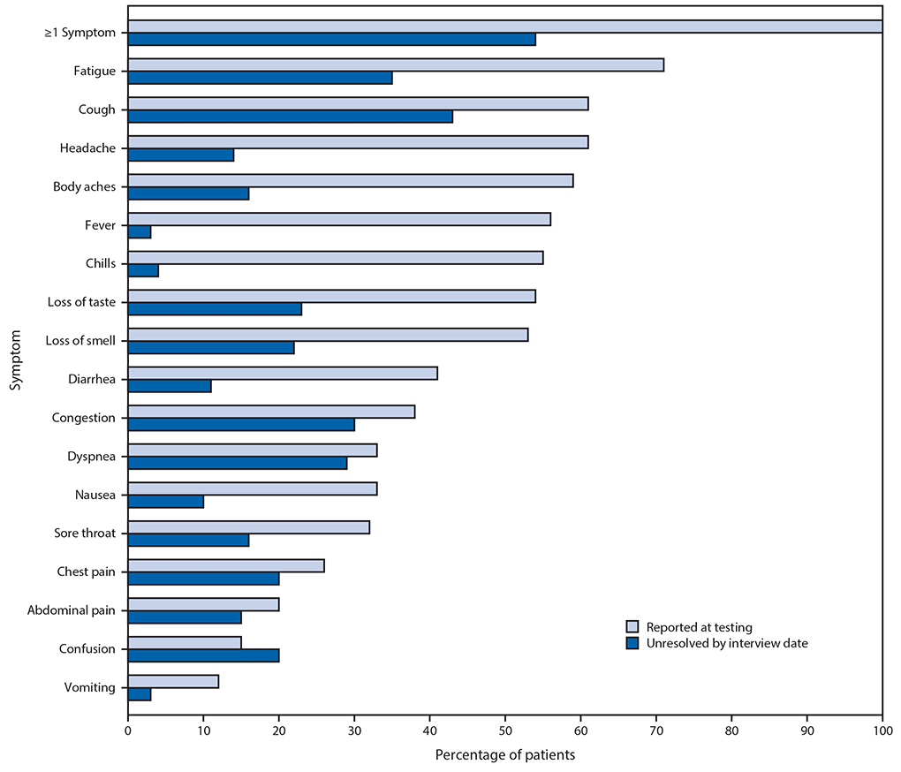

Slide 8
Wide Range of Severity
Asymptomatic 40-45%
Outpatient 40-35%
Hospitalized 20%
Ongoing medical care after D/C 45%
Long term rehab after D/C 4%
SNF 1%
Die (BTW- COVID mortality is declining) 3%

Slide 9
Organ damage in some severe cases
SARS-CoV-2 uses a spike protein on its surface to latch onto cells’ ACE2 receptors. The lungs, heart, gut, kidneys, blood vessels, and nervous system, among other tissues, carry ACE2 on their cells’ surfaces—and thus, are vulnerable to COVID-19.
Lungs – acute respiratory distress syndrome (ARDS) inflamed lungs become full of blood and fluid leading to fibrosis of lung tissue leading to permanent decreased lung capacity but less common than feared.
Heart - 20-30% of severe cases developed myocarditis leading to arrhythmias and a loss of cardiac capacity
Blood coagulation – blood cots to leg veins and heart
Kidneys – moderate to severe damage in up to 30% of severe cases
Brain – reports of seizures, hallucinations, confusion and Guilian-Barre’ syndrome

Slide 10
COVID Impact on Mental Health and SUD
Percent Reported | Anxiety | Depression | Serious SI
2019 | 8.1% | 6.5% | 4.3%
2020 | 25.5% | 24.3% | 10.7%
Increase | 3X | 4X | 2X
- Symptoms of a trauma- and stressor-related disorder (TSRD) – 30.9%
- Started or increased substance - 13.3%
- Serious Suicide Considerations significantly higher among respondents
- Aged 18–24 years (25.5%),
-Hispanic (18.6%) - Black (15.1%)
- Unpaid caregivers for adults (30.7%) - Essential workers (21.7%)
https://www.cdc.gov/mmwr/volumes/69/wr/mm6932a1.htm?s_cid=mm6932a1_x

Slide 11
Re-Infection?
Overall remains uncertain but increasingly likely that it will not be a significant problem
No unequivocally proven cases of reinfection to date
Purported cases of reinfection
None have grown out live virus
No reports of a person with re-infecting infecting new other
May have been protracted illness waxing and waning
Antibody levels drop rapidly within 1-3 months of infection but:
This is a common pattern in immune response
High initial levels are killer cells/antibodies
Immunity depends on a small residual of memory cells (M, T, and B cells)
Persist at levels is too low to detect for individual illnesses
reactivate rapidly

Slide 12
COVID Mutation
Changes more slowly than most other viruses
On average accumulates about two changes per month
Most of the changes don’t affect how the virus behaves
Mortality rate falling – cause unclear
More testing and better treatment
Selective pressure/mutation
One mutation (D614G) makes it more contagious but not more deadly
Affects spike on outside of virus
90% of cases in AZ
Another mutation (ORF8) also occurred it SARS and caused it to replicate slower
Mutation can impact vaccine efficacy

Slide 13
Vaccines
Phase | Pre-Clinical | One | Two | Three | Approved
Description | Animal Studies | testing safety and dosage | expanded safety trials | large-scale efficacy tests | approved for early or limited use
Participants |  | Small number | Hundreds | Thousands
Vaccines | 135 | 20 | 11 | 8 | 2
31 Vaccines in human trials total – 10 in Multiple phases
Different Approaches
Inactivated and Live Attenuated Virus (influenza, chickenpox, measles, mumps and rubella) 3 in phase 3
Protein based (HPV, Shingles, Hepatitis B) 0 in phase 3
Adenovirus (Rabies, Distemper, Ebola, HIV) 2 in phase 3
DNA or RNA 2 in phase 3

Slide 14
Vaccines Approved for Early Use
CanSino Biologics (Chinese) adenovirus vaccine called Ad5,, the Chinese military approved the vaccine on June 25 for a year as a “specially needed drug.” No phase 3 trial published.
Gamaleya Research Institute (Russia) produced a combination of two adenoviruses, Ad5 and Ad26, both engineered with a coronavirus gene. Approved on Aug. 11 before Phase 3 trials had even begun.
F.D.A. requires a coronavirus vaccine to protect at least 50% of vaccinated people to be considered effective.

Slide 15
Questions?
Thank You
for being an important part of
the National Council community.

