Slide 1
OSHA’s COVID-19 Vaccination and Testing Emergency Temporary Standard (ETS)
Molly S. Evans, Esq.
Dianne K. Pledgie, Esq.
November 16, 2021

Slide 2
Disclaimer
These materials have been prepared by the attorneys of Feldesman Tucker Leifer Fidell LLP. The opinions expressed in these materials are solely their views and not necessarily the views of Feldesman Tucker Leifer Fidell LLP.
The materials are being issued with the understanding that the authors are not engaged in rendering legal or other professional services. If legal assistance or other expert assistance is required, the services of a competent professional with knowledge of your specific circumstances should be sought.

Slide 3
COPYRIGHT NOTICE OF ORIGINAL MATERIALS
These slides are being made available to you and your organization as a participant of an FTLF training program. You are ONLY permitted to duplicate, reproduce and/or distribute these materials within your organization.
Note: a membership organization may not consider its members to be “within the organization” for purposes of sharing materials.
These slides may not be otherwise photocopied, reproduced, duplicated, and/or distributed outside your organization and/or posted on a website without prior written permission from the authors.
Any other use or disclosure is a violation of federal copyright law and is punishable by the imposition of substantial fines.
Copyright is claimed in all original material, including but not limited to these slides and other resources or handouts provided in connection to this training, exclusive of any materials from federal laws and regulations and any documents published by the federal government.

Slide 4
Agenda
Timeline of Important Dates and Events
Overview of OSHA’s COVID-19 Vaccination and Testing Emergency Temporary Standard (ETS)

Slide 5
Dates and events
September 9, 2021 | Biden Administration issues “Path Out of the Pandemic”
November 5, 2021 | ETS published in the Federal Register and goes into effect
November 6, 2021 | U.S. Court of Appeals for the Fifth Circuit temporarily stays OSHA’s enforcement of the ETS (petitions for review filed in other circuit courts)
November 12, 2021 | U.S. Court of Appeals for the 5th Circuit issues a stay on the ETS
December 6, 2021 | Deadline in the ETS for employers to comply with all requirements of the ETS except for the COVID-19 testing for employees who are not fully vaccinated (29 CFR 1910.501(g))
January 4, 2022 | Deadline in the ETS for employers to comply with all requirements, but employees who have completed the entire primary vaccination by that date do not have to be tested, even if they have not yet completed the 2-week waiting period: Deadline for comments on ETS to be received by OSHA

Slide 6
Purpose
29 CFR 1910.501(a)

Slide 7
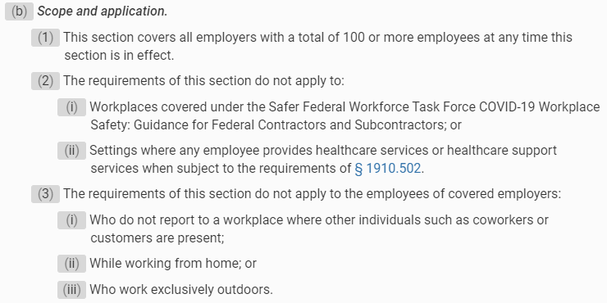
Scope and Application
29 CFR 1910.501(b)

Slide 8
Employer Policy on Vaccination
29 CFR 1910.501(d)

Slide 9
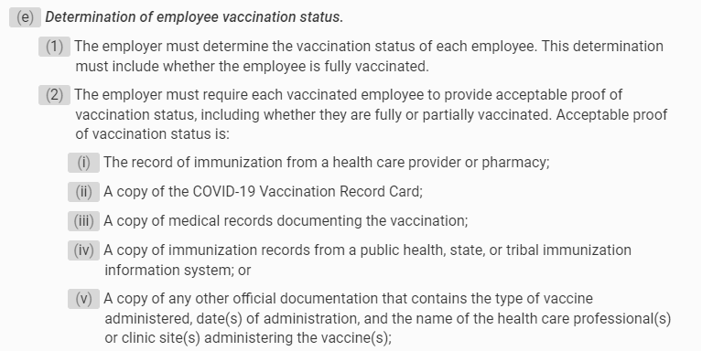
Determination of employee vaccination status
29 CFR 1910.501(e)

Slide 10
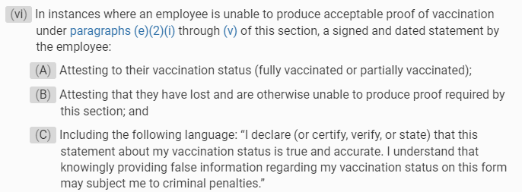
Determination of employee vaccination status
29 CFR 1910.501(e)

Slide 11
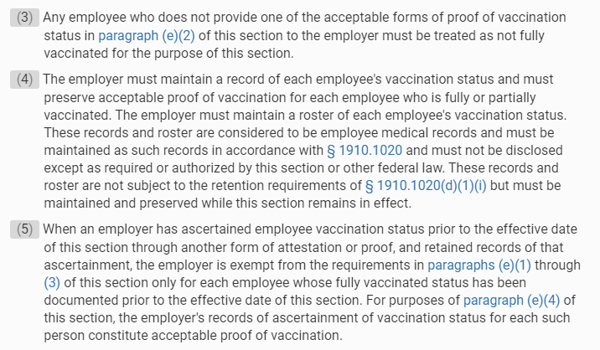
Determination of employee vaccination status
29 CFR 1910.501(e)

Slide 12
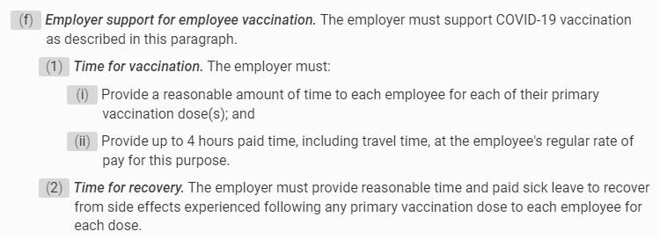
Employer support for employee vaccination
29 CFR 1910.501(f)

Slide 13
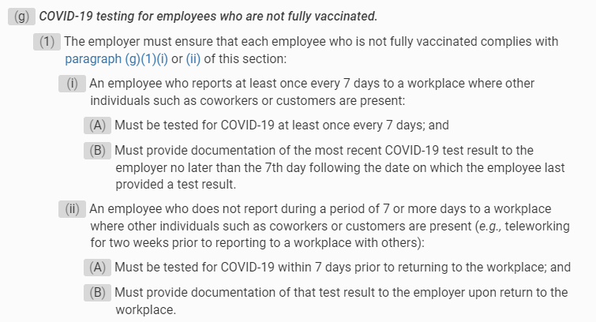
Covid-19 testing for employees who are not fully vaccinated
29 CFR 1910.501(g)

Slide 14
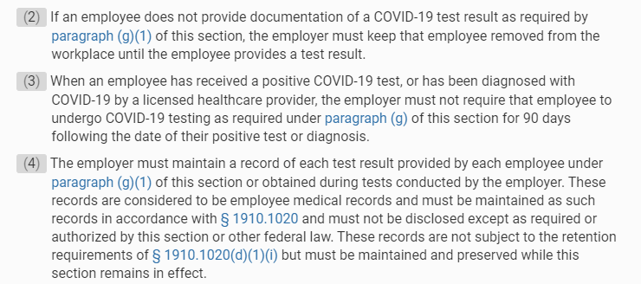
Covid-19 testing for employees who are not fully vaccinated
29 CFR 1910.501(g)

Slide 15
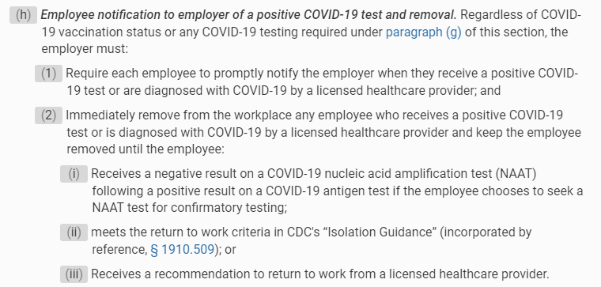
Employee Notification to employer of a positive covid-19 test and removal
29 CFR 1910.501(h)

Slide 16
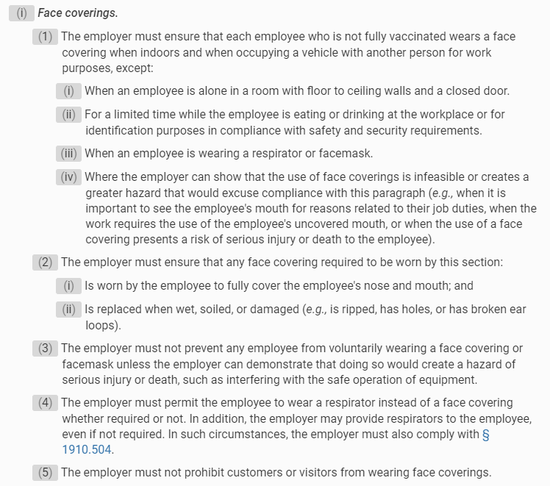
Face coverings
29 CFR 1910.501(i)

Slide 17
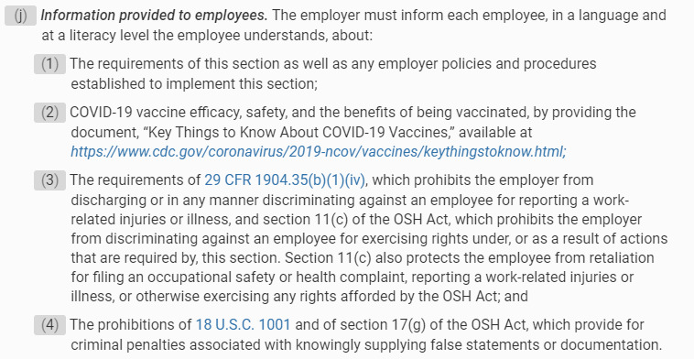
Information provided to employees
29 CFR 1910.501(j)

Slide 18
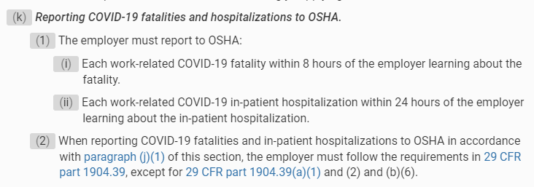
Reporting COVID-19 Fatalities and hospitalization to osha
29 CFR 1910.501(k)

Slide 19
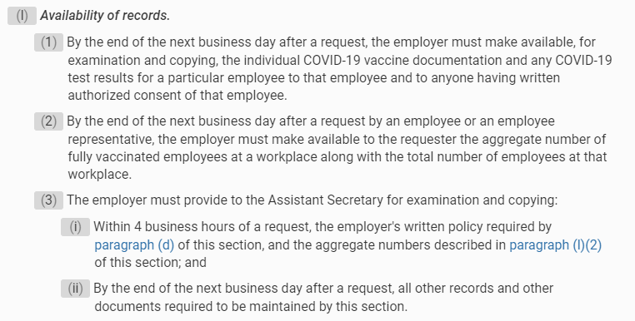
Availability of records
29 CFR 1910.501(l)

Slide 20
resources
29 CFR § 1910.501: https://www.ecfr.gov/current/title-29/subtitle-B/chapter-XVII/part-1910/subpart-U/section-1910.501
Interim Final Rule; Request for Comments: https://www.federalregister.gov/documents/2021/11/05/2021-23643/covid-19-vaccination-and-testing-emergency-temporary-standard
OSHA’s Website (includes face sheets, policy templates and FAQ: https://www.osha.gov/coronavirus/ets2

Slide 21
Contact Information
Molly S. Evans, Esq.
MEvans@ftlf.com
Dianne K. Pledgie, Esq.
DPledgie@ftlf.com
Feldesman Tucker Leifer Fidell LLP
1129 20th Street NW, Suite 400
Washington, DC 20036
(202) 466-8960
www.ftlf.com
http://learning.ftlf.com/

