Slide 1
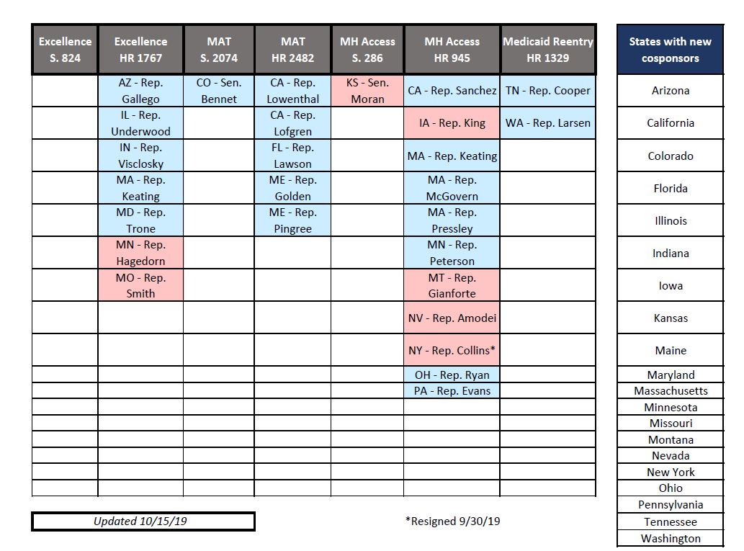
2019 New, Post-Hill Day Cosponsors

Slide 2
2019 New, Post-Hill Day Cosponsors
Excellence in Mental Health and Addiction Treatment Expansion Act
S. 824: 0 new / 13 total cosponsors
HR 1767: 7 new / 73 total cosponsors
Mainstreaming Addiction Treatment Act
S. 2074: 1 new / 3 total cosponsors
HR 2482: 5 new / 89 total cosponsors
Mental Health Access Improvement Act
S. 286: 1 new / 27 total cosponsors
HR 945: 11 new / 82 total cosponsors
Medicaid Reentry Act
HR 1329: 2 new / 4 total cosponsors

