Slide 1
Association Executives Demographic Assessment Summary Findings
September 19, 2022

Slide 2
Demographic Assessment - Objective
Objective - Establish a baseline of basic information on the diversity characteristics of the CEOs/Executive Directors of our member organizations.
This was not a statistically rigorous survey but an effort to elicit previously unrequested basic information on the diversity of our members’ CEOs/Executive Directors from those (100% Association Executives) who know them best.

Slide 3
Request for Information
100% Association Executives were asked (not to do a survey of their members, but) to provide any information they have, anecdotal or reported, on “how many and which of their association’s CEOs/Executive Directors are from diverse backgrounds”.
Specifically, including –
Female | American Indian or Alaska Native
Male | Native Hawaiian or Pacific Islander
White | LGBTQ+
Black or African American | Lived Experience
Hispanic or Latino | Disabled
Asian | Veteran
Notes:
100% Association Executives were asked to identify the gender of the CEOs/Executive Directors of their members. Most reported that females make up a significant majority of the heads of their member organizations.
Specifics (only if needed) -
829 members had a female CEO/Executive Director
723 had a male CEO/Executive Director
None indicated a CEO/Executive Director that is non-binary, transgender or intersex

Slide 4
Association Executives Diversity Survey - Timeline
March 16 – Survey sent to each 100% Association Executive in individual emails
April 27 – Individual email reminders sent throughout April to those who had not yet filled out the survey.
August 28-30 – Association Executives Retreat
June 3 – Analysis complete
March 15 – Survey discussed at monthly Association Executives meeting
March 31 -
Doyle Forrestal sent reminder email to 100% Association Executives
May 20 –
Survey closed. Analysis started.
June 13 -
Board DEI Workgroup meeting
Notes:
We also offered to have individual calls with Association Executives if they preferred.

Slide 5
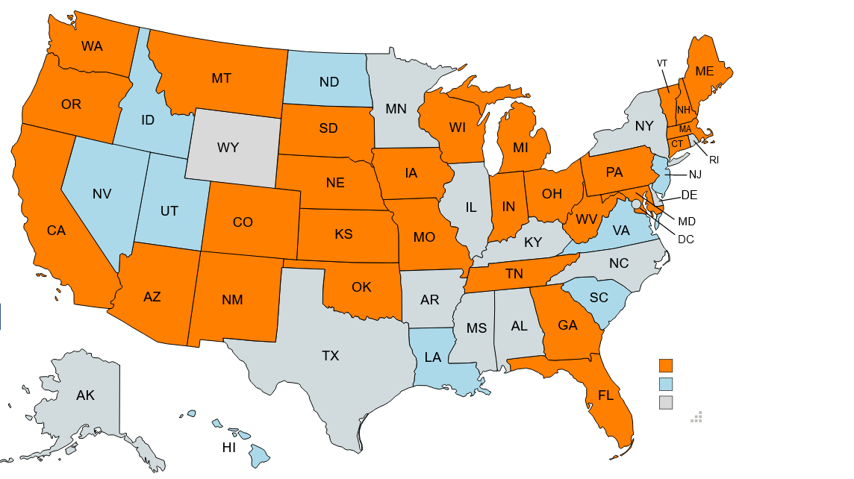
States of Assessment Respondents
31 respondents from 28 states
Orange = 100% Association Executives who completed the survey. These represent 2,364 members (74% of the National Council’s membership).
Blue = 100% State Government of no 100% association member.
Gray = no response.

Slide 6
Gender Composition
= Male Majority
= Even Male and Female
= Female Majority
Notes:
100% Association Executives were asked to identify the gender of the CEOs/Executive Directors of their members. Most reported that females make up a significant majority of the heads of their member organizations.
Specifics (only if needed) -
829 members had a female CEO/Executive Director
723 had a male CEO/Executive Director
None indicated a CEO/Executive Director that is non-binary, transgender or intersex

Slide 7
Racial and Ethnic Composition
Racial Composition Ethnic Composition
5%
= American Indian
or Alaska Native
= Asian
= Native Hawaiian or
Other Pacific Islander
= Black or African
American
= White
95%
Notes:
Association Executives were asked to identify the racial composition, and to identify the Hispanic or Latino composition, of the CEOs/Executive Directors of their members.
The U.S. Office of Management and Budget and the Census Bureau “considers race and Hispanic origin to be two separate and distinct concepts. Hispanics and Latinos may be of any race. Thus, the percent Hispanic should not be added to percentages for racial categories.” This survey and these results reflect this distinction.
Specifically -
87% were reported to be White
13% were reported to be Black or African American
4% were listed as “Not Certain or Unknown”
3% responded “Prefer Not to Specify”
95% were identified not to be Hispanic or Latino.
5% were identified at Hispanic or Latino.

Slide 8
Additional DEI Categories
CATEGORY | CEOs/Executive Directors (% Total)
… identifying as having a disability? | 29 (1%)
… identifying as LGBTQ+? | 29 (1%)
… identifying as a person with a lived experience (e.g., mental health condition, substance use disorder)? | 126 (6%)
… identifying as a veteran? | 36 (2%)
NOTE: Most Association Executives reported few or no CEOs/Executive Directors that met any of these categories. Accordingly, the CEOs/Executive Directors in these additional categories tended to be reported by a relatively small number of Association Executives. Some notable examples include:
1 reported 23 (40% of their members) with lived experience.
1 reported 39 (25%) with lived experience.
1 reported 15 (11%) as having a disability, 21 (16%) as having a lived experience, and 10 (7%) as being a
veteran.

Slide 9
Next Steps
It is not too late to complete the assessment if you have not already.
Results will be shared with the Board Diversity, Equity, and Inclusion Workgroup.
Assessment questions will be added to next year’s Association Executives Survey.

Slide 10
Q&A

