Slide 1
The Behavioral Health Market – Evolution & Disruption
National Council Board Meeting, November 12, 2019, 9:30 – 11:30 a.m.
Briefing, Monica E. Oss, Chief Executive Officer, OPEN MINDS
Notes:
“Only 270 members
The rest via associations
Goal: Key the current strategic plan
AM – 8:00 breakfast
9:00 Briefing
11:00 Board chari
12:00 lunch
1:00 – 4:45 discussion of objectives and tactics
What to accomplish and how?

Slide 2
I. National Drivers Of Change In The Financing & Delivery Of Behavioral Health Services

Slide 3
The Drivers Of The Changing Service Delivery Landscape
The Landscape
Mental Health & SDoH Drive Integrated & Coordinated Care
Changing Reimbursement
Emerging Consumerism
New Competition Driving Consolidation
New Technologies

Slide 4
5% Of Americans Consume Half Of All Health Care Resources This group of consumers is often referred to as “super-utilizers” – individuals with multiple illnesses whose care is uncoordinated and fragmented, resulting in high resource use
The Landscape
Much of this is due to frequent and preventable use of expensive health care settings - due to lack of a coordinated, person-centered care management
Upon discharge from a hospitalization due to mental illness, HEDIS measures show that more than 47% of commercially-insured individuals, 55% of Medicaid enrollees, and 64% of Medicare enrollees did not receive follow-up care within 7 days
More than 80% of Medicaid superutilizers have a comorbid mental illness
In 44% of Medicaid superutilizers, mental illness is in the form of an SMI
Notes:
Chakravarty, S., et al. (2014, Nov.). Role of Behavioral Health Conditions in Avoidable Hospital Use and Cost. Rutgers Center for State Health Policy. Retrieved from http://www.cshp.rutgers.edu/downloads/10530.pdf
Kindig, D. (2015, Apr. 6). What Are We Talking About When We Talk About Population Health?. Retrieved from http://healthaffairs.org/blog/2015/04/06/what-are-we-talking-about-when-we-talk-about-population-health
Citters, A., Lewis, V., Schoenherr, K., & Bartels, S. (2013). Organizational and Financial Integration of Behavioral Health into Accountable Care Organizations. The Dartmouth Institute For Health Policy & Clinical Practice. Retrieved from http//academyhealth.org/files/2013/sunday/vancitters.pdf

Slide 5
Behavioral Health Conditions Predict Increased Health Care Spending
The Landscape
Behavioral health problems cost
People with one or more behavioral health conditions spend
People diagnosed with a comorbid behavioral health and chronic health condition
$200 billion
per year, more than heart conditions, trauma, or cancer
$672 billion
annually on overall health care
Cost 300%
more than those with only a chronic health condition
Notes:
Sources: The Robert Wood Johnson Foundation. The Synthesis Project: New Insights From Research Results
Charles Roehrig, “Mental Health Disorders Top the List of the Mostly Costly Conditions in the Unites States: $201 Billion,” Health Affairs 35, no. 6 (2016)”1130 – 1135
Thorpe, Jain, and Joski, “Prevalence and Spending Associated with Patients Who Have a Behavioral Health Disorder and Other Conditions,” Health Affairs 36, no. 1 (2017): 124-132

Slide 6
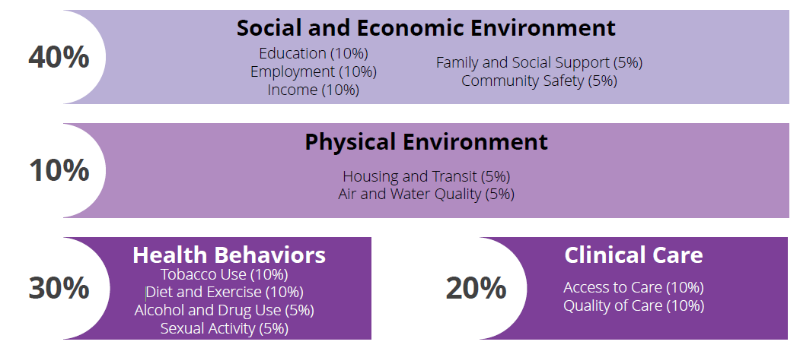
The Importance Of Social Factors – The Drivers Of Health Care Costs
The Landscape
Notes:
Kaiser Family Foundation: Beyond Health Care: The Role of Social Determinants in Promoting Health and Health Equity
Nov 04, 2015
http://www.kff.org/disparities-policy/issue-brief/beyond-health-care-the-role-of-social-determinants-in-promoting-health-and-health-equity/view/footnotes/#footnote-168746-4

Slide 7
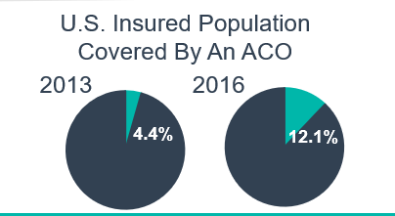
The result of parity, no annual and lifetime coverage limits, and better data… Payer preference for integrated care coordination - particularly for consumers with complex needs
Single care management entity per consumer - medical, pharmacy, behavioral, and social – all with some form of performance-based reimbursement
Accountable care organizations – Medicare, Medicaid, commercial
Bundled rate programs - Medicare and health plan
Health plan episodic case rates
Specialty care coordination programs – medical homes, health homes ‘whole person’ care coordination
The Landscape
In 2017, 1.3 million Medicaid consumers were served by 33 health homes in 22 state

Slide 8
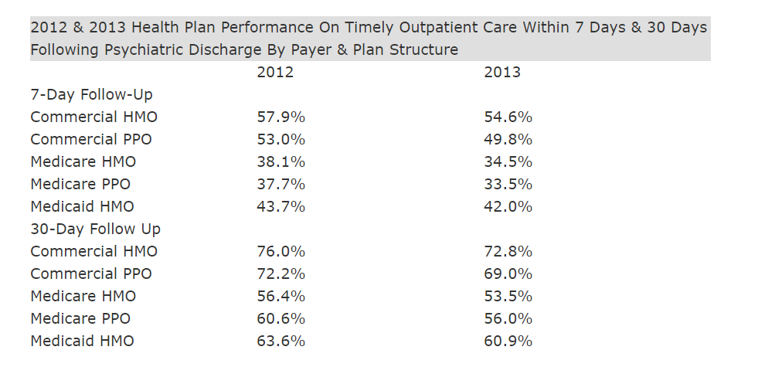
The Landscape

Slide 9
Coordination Of Care Strategies, %, All Health Plans, 2017 & 2019
Notes:
Developed by OAPI & Lundbeck. OPEN MINDS. (2019). OPEN MINDS Behavioral Health Delivery System, Proprietary Database. Retrieved from OPEN MINDS.

Slide 10
Adoption Of Telehealth, %, Health Plans, 2019
Adoption Of Scheduling-Related Initiatives, %, Health Plans, 2019

Slide 11
Changing Provider Reimbursement Models To Support “Integration”
The Landscape
Notes:
The 2018 OPEN MINDS Performance Management Executive Survey: Where Are We On The Road To Value?: https://www.openminds.com/market-intelligence/resources/2018-open-minds-performance-management-executive-survey-road-value/

Slide 12
CMS Changes Ahead
The Landscape
Medicare “Primary Cares Initiative” -- On April 22, 2019, CMS announced the the “Primary Cares Initiative” to implement five new value-based primary care models for Medicare fee-for-service (FFS) beneficiaries. CMS projects that nearly 11 million Medicare beneficiaries (25% of the total Medicare FFS population) could be served through the five new models. The six-year demonstration that will begin in January 2020.
Medicaid health homes for children - CMS is planning to launch Medicaid health homes to provide care coordination for children with medically complex or chronic conditions, with an option for pmpm reimbursement. By October 1, 2020, CMS will issue guidance on implementing this option with a target date of October 1, 2022.
The health homes are intended for children with serious, long-term physical, mental or developmental disability, or disease such as cerebral palsy, cystic fibrosis, HIV/AIDS, blood diseases, such as anemia or sickle cell disease, muscular dystrophy, spinal bifida, epilepsy, severe autism spectrum disorder, and serious emotional disturbance or serious mental health disorder.

Slide 13
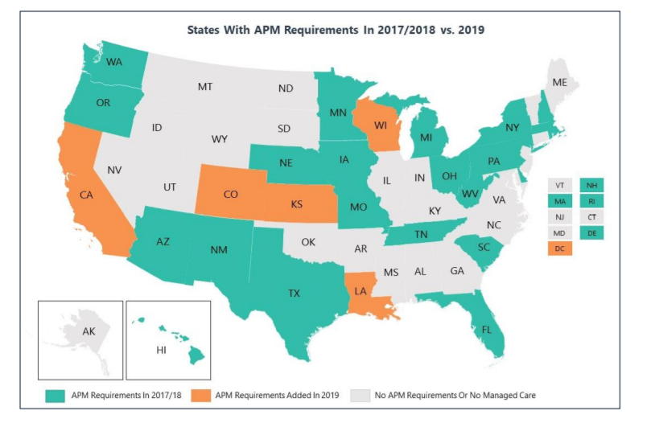
The Landscape
22 state Medicaid plans require their health plans to implement value-based provider reimbursement
At least 11 states have Medicaid ACOs
81% of Medicaid health plans have P4P FFS payments for behavioral health organizations
47% of Medicaid health plans have bundled payments for specific acute episodes

Slide 14
Use Of Alternative Reimbursement, %, All Health Plans, 2017 & 2019
Notes:
Developed by OAPI & Lundbeck. OPEN MINDS. (2019). OPEN MINDS Behavioral Health Delivery System, Proprietary Database. Retrieved from OPEN MINDS.

Slide 15
Kaiser Value-Based Targeted Case Management Program For SMI Population
The Landscape
Community-based, targeted case management for adults with severe mental illness
Contract with Providence Community Services in Los Angeles
Service area of Los Angeles, Orange, San Bernardino, Riverside, and Ventura counties
Commercial, Medi-Cal, and Medicare plans
Reimbursement on per member per month rate
Performance focus on cost reduction and improved HEDIS measure scores (reduction in hospital readmissions and improved outpatient follow-up post hospital discharge)

Slide 16
Optum SMI Behavioral Health Homes
The Landscape
Specialty care coordination program focused on members with SMI - integration of behavioral and physical health services, linkage to supports/services, and consumer support
Value-based contracting allows provider organizations to share in savings if meeting quality and efficiency measures
Optum provider oversight, data sharing, and practice transformation assistance
Expected outcomes:
↓ in BH/PH IP and ER cost with ↑ in BH OP cost
Reduced total cost of care

Slide 17
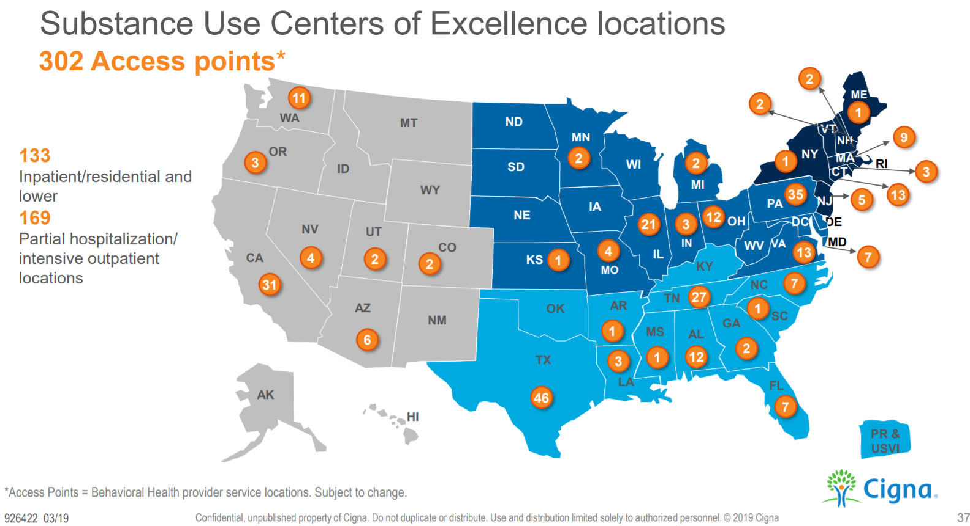
Cigna Substance Use Centers Of Excellence
The Landscape

Slide 18
Follow-Up After Hospitalization & Readmission Rates Are The Most Common Measures Of Performance
The Landscape
Top Five Performance Measures In Value-Based Contracts, %, 2019
Notes:
N=183 (# with managed care contracts)

Slide 19
The Landscape
Provider Organization Revenue In Value-Based Arrangements, By Market, %, 2019
74%
61%
58%
48%
45%
Notes:
# in each category with managed care contracts - 97, 31, 29, 26

Slide 20
The Landscape
Specialty Provider Organizations Participating In VBR, By Model Type, %, 2019
Notes:
N = 183 (# of orgs with managed care contracts)

Slide 21
Shifting Role Of Technology In Health & Human Services
The Landscape
Administrative Tool
Compliance Requirement
Platform For Competitive Advantage
Compliance focus the past ten years
Result - less focus on usability and clinical effectiveness
From ‘cost’ to ‘investment’
From ‘administrative management’ to ‘imbedded in service lines’
Essential for competitive advantage – and market positioning - over the next five years

Slide 22
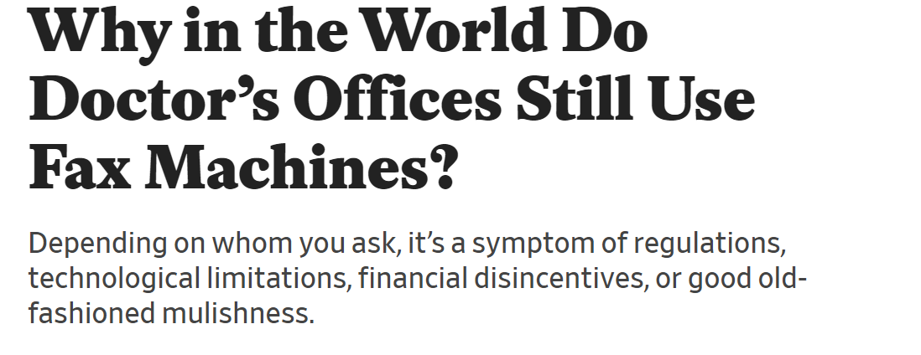
The Landscape

Slide 23
The Landscape
…only 7% of psychiatrists routinely use measurement-based psychiatric scales when planning consumer treatment…

Slide 24
The Technologies Most Frequently Adopted By Specialty Provider Organizations, %, 2019
The Landscape

Slide 25
The Landscape
Peer Support Specialist
Telehealth/
Telepsychiatry
Recovery Self-management Tool
Consumer Communication via automated email/text
MAT For Addictions
Colocation With Primary Care
Consumer-Directed Decision Support Tools
Medication Adherence Technologies/Programs
Injectable Medications For SMI
Re-admission Prevention Program

Slide 26
Leverage Of Technology To Reinvent Services Key To Competitive Market Positioning
The Landscape
Technology Creates New Competitive Forces
1. Convenient, personalized consumer treatment
2. Tech-enabled (and more effective) care coordination
3. Transparency in measurement of “value”
Telehealth and virtual consultation changing geographic market boundaries for services
Smartphone and other technologies for inexpensive consumer-directed disease management
Health information exchange provides data exchange and creates ‘big data’ for better consumer service planning
New treatment technologies have changed the options for consumers
Technologies permit task shifting to less expensive staff
Notes:
Oss, M. (2014, March 31). The Management Implications of Changing Reimbursement. OPEN MINDS Management Newsletter. Retrieved from http://www.openminds.com/market-intelligence/editorials/changing-reimbursement-impact-field.htm/
Oss, M., Raggio, S., & Cousino, S. (2013, March 20). Using Consumer Self-Help Tools to Improve Organizational Performance: myStrength Demo. Retrieved from https://www.thenationalcouncil.org/webinars/using-consumer-self-help-tools-to-improve-organizational-performance-mystrength-demo/.

Slide 27
One Challenge? The Number Of New Market Entrants In Tech-Enabled Health & Human Services
The Landscape
Category | Number Of Tech Products By Category
Administrative Cost Management | 1,603
Population Health Management | 1,582
Consumer Interaction | 1,131
Consumer Wellness & Health | 2,005
Data Management | 1,892
2,900
From OPEN MINDS database of tech solutions in the health and human service space
https://healthtechnavigator.org/
Notes:
This was created adding up the total amounts of all markets in each service line that was counted in a category.

Slide 28
The High “Fail Rate” Of New Technologies… Going From Concept To Scale Is Hard
The Landscape
Value proposition for the overall health and human service system – that includes administrative cost of maintenance
Lack of operational plan for scale - systemic operational workflow processes
Lack of integration into EHR and other larger data ecosystems
Human factors problems – payer, health plan, provider organization, professional, caregiver, and consumer
Proof of concept - proof of impact and proof of return-on-investment
Financial viability at scale – changes in FFS or VBR models
Marketing expertise of tech vendor – comprehensive plan and execution
Financial strength of tech vendors for the ‘long game’
41

Slide 29
The New Consumerism
The Landscape
Consumer Transparency
Consumer Financial Participation
Consumer Experience & Consumer Choice
Consumer Engagement
Consumer financial participation = Proportion of health care spending paid by the consumer
Expected results = Reduced costs by increasing engagement and reducing unnecessary expenses
Consumer transparency = Making available, in a reliable, and understandable manner, information on the health care system's quality, efficiency and consumer experience with care, which includes price and quality data
Expected results = Improved service quality and reduced costs
Consumer transparency = Making available, in a reliable, and understandable manner, information on the health care system's quality, efficiency and consumer experience with care, which includes price and quality data
Expected results = Improved service quality and reduced costs
Consumer experience = How consumers perceive their interaction with an organization, evaluated as useful, usable, and enjoyable - resulting in the consumer perception of an organization’s brand
Expected results = Improved consumer preference for certain provider organizations – while improving their level of engagement
Consumer engagement = Process to help individuals take action to improve their health, make informed decisions, and engage effectively and efficiently with the health care system
Expected results = Improved health status, reduced costs, and better access

Slide 30
The New Lexicon Of MA&A
The Landscape
The ‘Melting’ Value Chain Driving
Mergers, Acquisitions, & Affiliations
“Specialty care” boundaries
Virtual delivery systems
Health system function expansion – payer, provider, vendor
Health plan consolidation and backward integration
Geographic service boundaries
Health plan merger
Health plan backward integration
Health system merger
National health systems evolution
Health systems acquiring specialty capabilities
Specialty provider organization merger
National ‘specialty’ delivery system evolution
Health plans/pharma combinations
Provider organizations/pharma combinations
Pharma/tech combinations
Tech-enabled service delivery

Slide 31
New Competition From Health Systems
The Landscape
Some Of The Largest Health Systems – Annual Revenue
Ascension Health – $22.6 Billion
Trinity Health – $17.6 Billion
Catholic Health Initiatives – $15.5 Billion
UPMC - $11.4 Billion
Dignity Health – $10.2 Billion
Atrium Health - $9.8 Billion
John Hopkins Medicine - $8 Billion
Mercy Bon Secours – $8 Billion
LifePoint Health - $6.3 Billion
Providence Health & Services - $6 Billion
Northwestern Memorial Healthcare - $4.6 Billion
Adventist Health System – $3.9 Billion
Prime Healthcare - $3.3 Billion

Slide 32
Consolidation Continues In Specialty Service Providers
The Landscape
Some Of The Largest Specialty Provider Organizations – Annual Revenue
Universal Health Services (UHS) – $10.4 Billion | Elwyn - $276 Million
Kindred Healthcare – $6 Billion | Mosaic – $232.3 Million
Acadia Healthcare – $2.8 Billion | Bancroft – $146 Million
ResCare – $1.5 Billion | Woods Services – $132 Million
Civitas Solutions – $1.4 Billion | Public Health Management Corporation – $155.5 Million
Sunrise Senior Living – $1.2 Billion | Uplift – $118.1 Million
Merakey – $525 Million | Atria Senior Living – $64.2 Million
Capital Senior Living – $463.6 Million | Enlivant – $34 Million
Devereux – $429 Million | Sequel – $33.5 Million
Centerstone – $400 Million | Strategic Behavioral Health – $29.6 Million
American Addiction Centers – $318 Million | KidsPeace – $28.5 Million

Slide 33
“Therapy” Is Evolving
The Landscape
Consumers’ access to treatment will be determined by the health care coverage, their health plan choice, and their personal income.
Mental health treatment and other ‘therapy’ will often happen within integrated systems of care.
Tech-enabled treatment will be the rule, rather than the exception.
Consumers will have more limited choices of therapies - of provider organizations, professionals, and treatment models.
“Hybrid” virtual/physical behavioral health delivery systems emerging.

Slide 34
Virtual Behavioral Health Delivery Systems Created With Private Equity Investments
The Landscape
Disruptive!

Slide 35
The Landscape

Slide 36
Remaking Primary Care
The Landscape
Health plans with virtual primary care (Humana, Oscar)
Primary care at home (Wellcare, Humana)
Retail chains – 1,100+ locations, offer specialist consults virtually, partnership with VA
Backward integration of primary care functions in health plans – Aetna, Kaiser, United/Optum, Humana, etc.
Changing scope of practice – psychologists, nurse practitioners, physician assistants, and pharmacists
‘Augmented intelligence’ can support basic primary care functions – assessment, prescription, referrals
Specialist services provided via virtual care within primary care model
Growing payer preference for "specialty" primary care (and specialty medical homes)

Slide 37
The Landscape
WellCare Health Plans and VillageMD announced a partnership to offer in-home primary care to improve access to health care for medically-complex seniors in the Houston area
Village@Home integrates pharmaceutical management, nursing services, and social work services into its home-based primary care program
VillageMD will coordinate services and monitor the health care consumer through in-home biometric technology
WellCare
In-Home Primary Care Model

Slide 38
Humana “On Hand” Virtual Primary Care Plan
Humana has created a partnership with telehealth platform Doctor on Demand to create On Hand for virtual primary care
Based on Doctor on Demand's Synapse virtual primary care platform, designed to integrate into health plans' existing networks.
Members pay nothing for primary care visits using Doctor On Demand and a $5 copayment for common lab work and prescriptions on the platform.
“Significantly lower” premium cost
On Hand features include:
Video visits and secure messaging
A dedicated primary care professional
Access to board-certified physicians, psychiatrists, psychologists, and nurse practitioners
Standard medical device kit consisting of a digital blood pressure cuff, thermometer, and log
Notes:
https://www.businesswire.com/news/home/20190424005233/en/
https://www.businesswire.com/news/home/20190424005233/en/Humana-Doctor-Demand-Launch-Virtual-Primary-Care

Slide 39
What Are Key Disruptive Forces In Health & Human Services?
The Landscape
Transportation companies facilitating in-home services – Uber, Lyft, UPS
Performance-based purchasing of pharmaceuticals (UPMC Health Plan, State of Oklahoma)
Amazon’s investment in PillPack – what else will they (and others) sell online?
Pharmaceutical companies entering the tech-enabled service space (Otuska and MyCite, Sandoz and Pear Therapeutics)
Payers limiting consumer choice for specialty services to “Centers of Excellence (WalMart)
Chains of low-cost, convenient service centers (CVS/Aetna)
Health plans paying for, and being reimbursed for, social services (Kaiser, United, Humana – CMS/Medicare rule changes)
“Netflix” pricing model for pharmaceuticals – and what else? (State of Louisiana, State of Washington)
Augmented-intelligence companions (Amazon’s Alexa, Jibo, Paro)
National chains for high-value specialty providers winning national contracts with payers (Clean Slate, Virtua, SurgCenter Development)
Smart homes (Google-powered AI in health care – Nest & Google Home)
The expansion of virtual care (United/Optum – telehealth expansion)

Slide 40
II. Positioning For Future Success

Slide 41
Strategy For Future Sustainability
The question for behavioral health management teams – how to address these market changes?
“Talk” therapy – hybrid virtual models for behavioral health
Social services funding - emerging P4S models
Specialty provider organization sustainability – challenged in move from volume to value
Primary care and care coordination – new functions, new people, new settings
VBR “opening the floodgates” for tech substitution
For traditional CMHCs, loss of Medicaid marketshare drives need to compete and innovate

Slide 42
Role For Specialist Provider Organizations Changing
Strategy For Future Sustainability
For specialist provider organizations serving consumers with complex needs, two emerging market positions
Whole Person Care
Stabilization & Crisis Management
Manage consumers with complex conditions and keep them out of acute care settings
Provide acute stabilization for complex consumers and coordinate a return to the community
Demand for - and margins of - traditional FFS ‘money makers’ shrinking –
Therapy-based services
Targeted case management
Undifferentiated “residential” treatment
Post-surgical SNF care
Notes:
community-based care to keep consumers from being admitted to acute care settings and support services to transition consumers to the community after an acute care stay.
provider organizations that have the ability to provide acute stabilization for consumers with complex behavioral/cognitive disorders, and coordinate a return to and support of their community-based providers on some form of episodic, bundled, or case rate payment.

Slide 43
Finding a new and sustainable “place” in the new market value chain is the strategic challenge…
Strategy For Future Sustainability
New competitors cannibalize some revenues for current services
New payment models change the profitability of current services
New service offerings make current services less ‘preferred’
RESULT: Current service line revenue – and margins – likely to shrink over time
STRATEGIC CHALLENGE: Becoming something ‘completely different’ that is preferred (and sustainable) in the changing market
Growth is the key – for competitive advantage and for scale…

Slide 44
The Sustainable Platform = High Value
Strategy For Future Sustainability
Community-based
Value
Tech-enabled
Customer-centric
Metrics-driven

Slide 45
Strategy For Future Sustainability
The Challenge: Optimize The Past To Build The Future
& Then Leave The Past Behind…
Strategy for future sustainability
Mission and objectives
Organizational market positioning
Restructured service line portfolio with competitive advantage
Strategy implementation
Manage and optimize the current service line portfolio
Develop service lines with competitive advantage for the future

Slide 46
Strategy For Future Sustainability
Strategy Is The Roadmap…
Strategy Considerations
Long-term vision
Organizational objectives
Market positioning – relative to competitors
Customer/payer preferences
Sustainability
Diversification
Strategy for future sustainability
Mission and objectives
Organizational market positioning
Restructured service line portfolio with competitive advantage
Strategy implementation
Manage and optimize the current service line portfolio
Develop service lines with competitive advantage for the future

Slide 47
Strategy For Future Sustainability
Strategy Implementation Is the Journey…
Making Strategy Work
A detailed plan – synced with budget
Metrics-driven – customer expectations, competitor performance
Key performance indicators
Assessment of available resources –
Talent and human capital
Brand
Administrative infrastructure
Standardization of service delivery models
Culture
Time
Capital
Strategy for future sustainability
Mission and objectives
Organizational market positioning
Restructured service line portfolio with competitive advantage
Strategy implementation
Manage and optimize the current service line portfolio
Develop service lines with competitive advantage for the future

Slide 48
Strategy For Future Sustainability
Portfolio Management Is Essential…
Strategy for future sustainability
Mission and objectives
Organizational market positioning
Restructured service line portfolio with competitive advantage
Strategy implementation
Manage and optimize the current service line portfolio
Develop service lines with competitive advantage for the future
Optimizing the Current Service Line Portfolio
Ability to participate in health plan contracts
Ability to accept value-based reimbursement for current services
Improved consumer access and engagement
Optimized revenue cycle management
Margin management
Discontinuing ‘non strategic’ service lines

Slide 49
Strategy For Future Sustainability
Creating The ‘Cash Cow’ Of the Future…
Strategy for future sustainability
Mission and objectives
Organizational market positioning
Restructured service line portfolio with competitive advantage
Strategy implementation
Manage and optimize the current service line portfolio
Develop service lines with competitive advantage for the future
Developing Service Lines With Competitive Advantage For The Future
“Best” market metrics
Market positioning with ‘sustainable role’
Structured plan for service line design, development, and launch

Slide 50
Management Initiatives For Optimizing Organizational Performance
Strategy For Future Sustainability
Implementing Metrics-Based Performance Management
New Approaches To Strategy & Strategy Implementation
Models For Participation In ‘Integrated Care’
Preparation For Value-Based Reimbursement
Leadership For Transformation & Complexity Management
Leveraging Available Technology To Improve Operating Efficiencies
Growth & Scale – Fundraising, Grants, Supplemental Service Lines, Or Mergers, Acquisitions, & Affiliations

Slide 51
Strategy For Future Sustainability
Metrics-Based Performance Management Is Key – Key Performance Domains For Health & Human Service Provider Organizations
“High Performing” On Payer Contracts
The Speed & Cost Factors
The Consumer Experience
Search engine ranking and optimization scores
Inquiries
Inquiry response time
Inquiry conversion rates
Time to appointment
Service rates
Net promoter score
Customer satisfaction
Customer experience monitoring (“mystery shopper”) results
Clinically Cutting Edge
Current in clinical and service practices
Short time to evaluation and adoption of new treatment technology
Financial Sustainability
Revenue – by service line
Liquidity – current ratio, days cash outstanding, cash flow from operations, days of accounts receivable
Profitability – revenue growth and net operating profit margin, by service line
Leverage – debt to equity ratio
National health home measures
NCQA HEDIS measures
CMS STARS measures
Most common health plan contract measures
Specific health plan contract measures
Specific funder performance measures
Consistency in ‘treatment model’ – lack of unexplained variability
Online reputation
Rate-value linkage

Slide 52
Strategy For Future Sustainability

Slide 53
Scale is essential to future sustainability.
The value of scale – for investment, for market leverage, to attract talent, for competitive unit costs…
The question is how to grow?
Strategy For Future Sustainability
Fundraising and grants
Extensions of current payer relationships and service line extensions
Diversification with new service line development and new customer base
Mergers, acquisitions, and affiliations
Size alone does not provide scale – many large organizations don’t have scale because they have too many different programs that prevent leverage of their infrastructure or growth of their talent ratio

Slide 54
The “Do It Now” Technologies
The OPEN MINDS Do It Now List!
Strategy For Future Sustainability
Electronic health recordkeeping system optimization – with tech-enabled scheduling, care authorization tracking, and revenue cycle management
"Small data" for performance management – pull together data that you have (and can get electronically)
Web site 2.0 - Better consumer experience – search engine optimization for consumer outreach; on-line scheduling, on-line chat, AI chat bots, insurance information, etc.
Virtual health/telehealth capacity – including on-demand specialist consultations
Automated appointment reminders and reminders of follow-up activities
Automation of consumer assessments with on-line and smartphone-based tools for measurement-based care
Automated human resource management tools – hours tracking, payroll, scheduling, etc.
Unit costing and P/L by service line with more advanced analytics capabilities for cost analysis
Mobile platforms for team members with secure messaging – to facilitate consumer interaction, connection to EHR data, and HR administration
Consumer remote monitoring tools – wearables, smart phone apps, in-home devices – to improve operating processes
43

Slide 55
Ability To Lead (Or Participate In) Integrated Care Coordination
Payers seeking better value through integrated management of consumer services – ideally funded with value-based/risk-based models
The ‘new’ integrated care coordination model – primary care, specialist care, medications, behavioral health, and social supports
Don’t need to provide all the care – but do need the ability to participate in ‘integrated systems’ and ‘manage’ across the full health and human service continuum
The “care manager” controls the referrals
The changing model of “primary care”
Many forms of integrated care coordination:
Specialty care coordination
Patient-centered medical home
Health home

Slide 56
Value-Based Reimbursement Competency

Slide 57
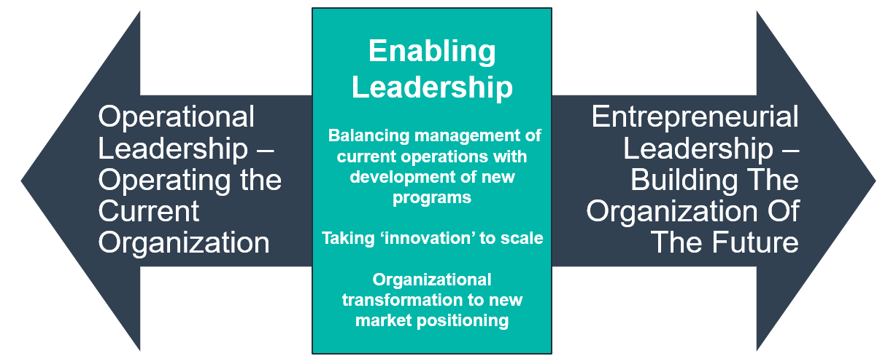
Leadership With Ability To Manage Complexity

Slide 58
The Executive Team That Can Manage Complexity…
Comfortable with uncertainty – and confident that, even with ambiguity, information and patterns will provide clues for guiding action.
Sacrifice for the bigger objective - ensuring ongoing viability and fitness of the organization.
Willing to risks in new initiatives - and humble enough to step back so others can step forward.
Trust in ability to innovate - and engage in it with strategic thinking and a keen sense of timing
Comfortable with tension and willing to use it - including putting others in tension in ways that may at times make them uncomfortable

Slide 59
Sustainability In Health & Human Services Needs A Measured Approach To Respond to Market Changes
Innovation
Value, Competitive Advantage, & Sustainability
Improved Performance
Strategy
New Partnerships
New Service
Reduced Cost
Sustainable Competitive Service Model
New Population
New Tech

Slide 60
“An important scientific innovation rarely makes its way by gradually winning over and converting its opponents… What does happen is that the opponents gradually die out.”
Max Planck

Slide 62
Why do we Exist? Our purpose is to ensure people with mental illness and/or addictions get effective care when and where they need it.
Our Core Values
↑ Be Curious ↑ Shape the Future ↑ Be a Team Player ↑ Bias to Action ↑
Strategic Goals
Assertive Public Policy
Organizational and Operational Excellence
High-Impact Communications
Effective Workforce and Leadership Investment
Premier Public Education – Mental Health First Aid
Public policy remains our number one priority in support of our members and the patients they serve
Identifying how to ensure employees’ commitment and connection to their work, and maintaining a two-way dialogue for continuous interaction and feedback
Elevate our brand to be the premier association for timely and accurate information about MH and addiction policy, prevention, treatment, and recovery services
Ensuring our work meets the needs of our members and we are responsive and valued partners
Brand MHFA as the leading vehicle for public knowledge of mental health and addiction disorders and appropriate responses to someone in distress
© The Insights Group Ltd, 2004-2019. All rights reserved.

Slide 63
Core Values

Slide 64
Strategic Goals
Assertive Public Policy
Effective Workforce and Leadership Investment
Organizational and Operational Excellence
Premier Public Education – Mental Health First Aid
High-Impact Communications

Slide 65
Goal 1: Assertive Public Policy
Strategies:
Protect and expand funding from all funding sources for addiction and mental illness prevention, treatment and recovery supports.
Strengthen advocacy collaboration and coordination across the National Council, our network of state and local associations, and member organizations.
Ensure expertise in current and proposed care delivery structures, services and payment models, including Certified Community Behavioral Health Clinics.
Identify and advocate for policies that prevent disability while promoting the full social inclusion of individuals with addictions and mental illnesses.
Support national and state efforts to disseminate parity information, monitor suspected violations, and ensure assertive implementation/enforcement.

Slide 66
Goal 2: Organizational & Operational Excellence
Strategies:
Position the National Council as a leading source for practice improvement information and technical assistance on clinical and operational excellence when serving individuals at risk of/with mental illness or addiction
Increase the National Council’s (board, staff, and members) knowledge of the characteristics and elements needed to succeed as Certified Community Behavioral Health Clinics.
Provide consumable technical assistance and other guidance to support behavioral health providers as they navigate payment and service delivery changes being promoted at the national and state levels.
Identify and encourage adoption of technologies, service delivery models, workflows, and business operations that promote consumer engagement, enable measurement-based care, and support data-based decisions.

Slide 67
Goal 3: High-Impact Communications
Strategies:
Leverage initiatives from policy, practice improvement, Mental Health First Aid, and Medical Director’s Institute to increase the public and policy makers understanding of and support for mental health and addictions service continuum.
Elevate the National Council brand to be the premier association among media, public safety and policy makers for timely and accurate information about mental health and addiction policy, prevention, treatment, and recovery services.
Expand advocacy/education efforts at the state level, supporting and helping mobilize grassroots, and state-level communications and messaging.
Use innovative communications tools including social media, traditional media, marketing, and web tools, to brand members as preferred organizations in the health care marketplace.
Provide timely and relevant curated information and opinion pieces – across topics related to the general health field as well as behavioral health – in multiple formats to member organizations and the stakeholder community.

Slide 68
Goal 4: Effective Workforce and Leadership Investment
Strategies:
Increase opportunities for all levels of behavioral health staff to enhance their clinical and professional leadership skills development in alignment with current and future markets.
Contribute to the development of effective organizational managers and leaders, particularly those that reflect the demographics of consumers and communities.
Support the hiring, training, and promotion of people with lived experience.
Invest in National Council staff development and in recruiting new staff who are/will become nationally recognized experts in their content or business areas.
Leverage the Medical Director Institute to advance clinical quality of members and policy informed by the best current evidence.

Slide 69
Goal 5: Premier Public Education – Mental Health First Aid
Strategies:
Brand MHFA as the leading vehicle for public knowledge of mental health and addiction disorders and appropriate responses to someone in distress.
Promote Mental Health First Aid research, evaluation, and return on investment studies to support credibility and adoption.
Create nationally-driven MHFA growth pathways: employer-based partnerships; nonprofit partnerships including law enforcement and first responders; health systems; and higher education.
Drive local government/community strategies for population penetration of MHFA.
Promote MHFA government mandates and continuing education courses and credits.
Invest in MHFA curriculum redesign (structure, content, and digital delivery); MHFA data collection and analysis; and innovative MHFA business models and diversification.

Slide 70
Key Objectives For Next 3 to 5 Years

Slide 71
Key Initiatives For Next 3 to 5 Years

