Slide 1
2022 Association Executives Survey Summary of Findings
Monday, September 19, 2022

Slide 2
Association Executive Survey Overview
The Association Executive Survey is completed annually.
Association and Members’
Characteristics and 990 Data
Association Budgets, Revenue, and Dues
Executive Information and Staffing
Survey was completed by 36 state Association Executives (out of 61) between June 2022 and August 2022.
Policy and Lobbying
Advocacy
The results do not reflect the entirety of the National Council’s membership.
Notes:
The Association Executives Survey is designed to be a helpful tool for you and to provide baseline information to help you strengthen your association.
The survey is results provide insights into five key areas.
The National Council conducts this survey each year and it features many of the same questions each year so that we can highlight trends based on year-to-year comparisons.
This data does not include all states and we are still collecting results from some states.

Slide 3
Association and Members’ Characteristics

Slide 4
Number of Provider Members
Notes:
The number of provider organizations for each association reporting ranges from a minimum of 13 to a maximum of 360. There are an average of 55 provider organizations for the associations that complete the survey.

Slide 5
Number of Affiliate/Vendor/Corporate Partner Members
Notes:
28 Association Executives (74%) stated that they have none or less than 10 affiliate/vendor/corporate partner members.
10 associations (26%) reported having 10 or more affiliate/vendor/corporate partner members.
There is more information on association revenue diversification in an upcoming slide.

Slide 6
Percent of Members Providing Both MH and SU Services
Notes:
When Association Executives were asked which provider types are represented by their associations, almost all indicated that most all of their members (93%) provide both substance use treatment and mental health treatment.
This is a slightly higher percentage than last year when Association Executives reported that 88% of their members provided both mental health and substance use treatment.

Slide 7
Provider Types Represented
PROVIDER GROUP | COUNT (% TOTAL)
Substance Use | 36 (95%)
Mental Health | 35 (92%)
Children/Adolescents | 26 (68%)
Hospitals/Health Systems | 15 (39%)
FQHCs/Look-alikes | 13 (34%)
Foster Care | 13 (34%)
Intellectual/Developmental Disabilities | 11 (29%)
Rehab Services | 11 (29%)
Managed Care Organizations | 6 (16%)
Other | 11 (29%)
Which of the Following Provider Groups Does Your Association Represent? [check all that apply]
Notes:
National Council members provide a wide range of treatment services to those in need in their communities.

Slide 8
Provider Members’ Organization Types
Notes:
Non-profits comprised most of the provider members represented. Of the 36 Association Executives reporting, 26 said the overwhelming majority of their provider members were non-profits, with 8 stating that all of their provider members were non-profits.

Slide 9
Provider Members’ Revenue Sources
Notes:
Most associations reported that at least half of their provider members’ revenue was from Medicaid, with many stating that all of their provider members’ revenue came from Medicaid.

Slide 10
Members’ 990 Data

Slide 11
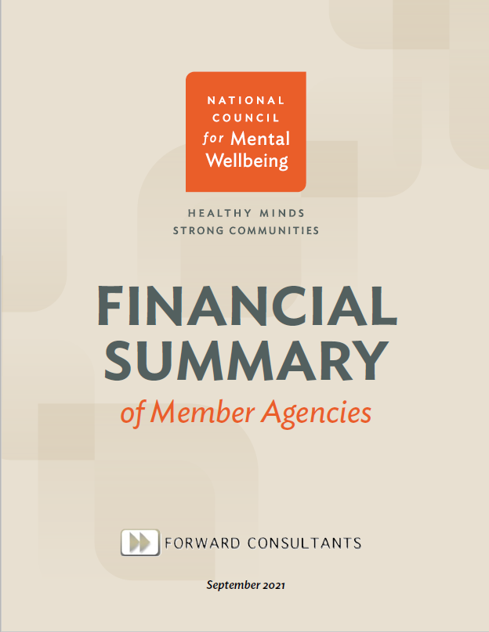
990 Report Overview
Report Objectives
Offer a profile of provider members
Segment National Council members into cohorts to enable peer to peer comparisons specific to profitability and financial health metrics
Provide audiences with relevant financial data
Report Sections
Profile of member agencies
Financial segmentation by cohorts
Profitability of member agencies (e.g., Median Net Margin)
Financial health of member agencies (e.g., cash and savings)
Search for “Understanding Your Financial Health” on National Council Website
Notes:
Later this fall, we will have an updated report with analysis of the 990 return data for most of our and your members.
We will present the results of this data at the monthly Association Executives meeting in November or December.

Slide 12
Members Revenue and Number of Employees
Total Revenue (CY 2018 - CY2020) | Number and Percentage of Member Agencies Meeting Criteria | Median Number of Employees (Across CY 2018 - CY 2020)
Less than $2.5M | 255 (18%) | 28
$2.5M -- $9.9M | 467 (33%) | 109
$10M -- $24.9M | 363 (26%) | 303
Over $25M | 320 (23%) | 732
Notes:
Just a preview of that data -
More than half of our members have less than $10 million in revenue.
Nearly one quarter of members have more than $25 million in revenue.
This information comes from the 990 return data from more than 2/3 of our members which we got from Candid (which was formerly known as Guidestar).

Slide 13
Association Budgets, Revenue, and Dues

Slide 14
Association Budget Sizes
What is the Total Annual Association Budget for 2022?
Budget size | % and Number of Associations Reporting
Under $500,000 | 38% (8)
$500,000 - $1,499,000 | 33% (7)
$1,500,000 and above | 28% (6)
Notes:
Here are the estimated total annual association budgets for 2022.
38% reported that their respective associations had a budget of less than $500,000 in 2022.

Slide 15
Associations Revenue Diversification
What percentage of your Association’s revenue comes from the following?
Notes:
Membership dues is the primary source of revenue for National Council member associations.
Two-thirds of Association Executives reported that most of their association’s revenue was from membership dues.

Slide 16
Growth of Non-Dues Revenue as Percent of Budget
Since this time last year, has Non-Dues revenue…
40% (12) Associations saw non-dues revenue increase
47% (14) Associations’ non-dues revenue stayed the same
13% (4) Associations saw non-dues revenue decrease
Notes:
Overall, most Association Executives said that non-dues revenue as a percent of their budget either stayed the same or increased since last year.

Slide 17
Membership Dues Models
STRUCTURE | COUNT (% TOTAL)
By Organization Budget/Revenue | 29 (85%)
Flat Rate | 6 (17%)
By Population Served | 4 (12%)
Based on Geography | 2 (6%)
Other | 2 (6%)
How Are Your Membership Dues Structured?
Notes:
The overwhelming majority (85%) of Association Executives said their membership dues are structured by organization budget/revenue.

Slide 18
Executive Information and Staffing

Slide 19
Years in Current Role
Notes:
Roughly half of Association Executives have been in their roles for 6 to 10 years.

Slide 20
Base Salary
Notes:
Almost two-thirds (63%) of Association Executives reported having a base salary between $100,000 and $200,000 per year.

Slide 21
Number of Employees
Notes:
Most associations reported having 10 or fewer staff.

Slide 22
Policy and Lobbying

Slide 23
External/Contract Lobbyist Expense
Notes:
Three out of four Association Executives (76%) said they use an external lobbying firm/contracted lobbyist.
Among these, the reported monthly retainer for the lobbyists ranged considerably.

Slide 24
Did Your State Make Budget Cuts Impacting Your Members this Year?
Notes:
In last year’s survey, 61% of respondents said that they expected state budget cuts to impact their members – so this year turned out better than expected.
Looking ahead, 90% of Association Executives reported that they do not anticipate that their state will make budget cuts that will impact their members this coming year.

Slide 25
Associations’ Top Policy Wins This Year
Eliminated co-pay on some insurance plans
Workforce recruitment and retention through wage and rate increases
Rate/reimbursement increases
Increased training opportunities
ARPA funding
Emergency relief funds
CCBHC certification
Telehealth legislation
Notes:
When asked about their top three policy wins over the past year, the Association Executives identified the following summary themes.

Slide 26
Associations’ Top Policy Priorities Next Year
CCBHC implementation and implementation
Workforce support
Expansion of available prevention, treatment, and recovery services
Medicaid substance use and mental health reimbursement rate increases;
Decreasing administrative burden
Payment reform
Notes:
When asked about their respective top three policy objectives for the coming year, Association Executives identified these themes.

Slide 27
How Many Staff Support Additional Policy Work?
Notes:
Association Executives ranged considerably in the reported number of staff supporting additional policy work.

Slide 28
What Advocacy Services Do You Provide to Your Members?
Notes:
All of the Association Executives stated that they provide policy advocacy with state agencies and state legislators to their members.
The majority also offered direct lobbying, action alerts, and grassroots mobilization.

Slide 29
Q&A

