Slide 1
Corporate Partner, Strategic Partner, & Affiliate Member Meeting
Wednesday, June 17, 2020

Slide 2
To Join the Conversation: Tips and Tricks
Please update your name to include your organization (e.g. Stephanie Swanson – National Council)
Set your camera at eye level for the best view of you.
MUTE your microphone when you’re not talking.
Want to speak?
If you would like to speak (but may be having difficulty breaking in) please click on “Participants” at the bottom of the screen, then click on “Raise Hand”
Prefer to write?
Type in the chat box located at the bottom of your screen.
You can choose who to send a chat or question to.

Slide 3
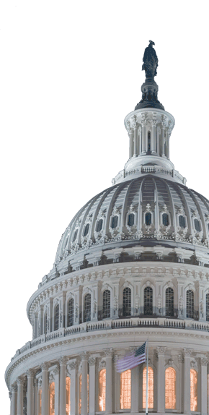
Federal Update from Washington
Reyna Taylor
Vice President, Public Policy
National Council for Behavioral Health

Slide 4
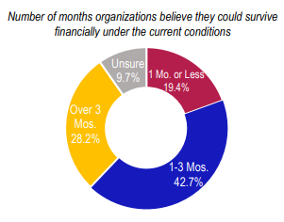
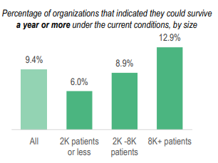
Member Survey: Economic Impact of COVID-19 on Behavioral Health Organizations
Programs and Patients
Organizations have cancelled, rescheduled, or turned away 31% of patients
92% have reduced operations
Employment
46% have laid off/furloughed employees
Personal Protective Equipment (PPE)
83% don’t have enough PPE for 2 months
Resilience
62% believe they can only survive financially for 3 months or less under current COVID-19 conditions
Notes:
Patient and Program Impact even worse for smaller organizations (turned 36% of patients away)
Larger organizations have had to lay off at higher rates

Slide 5
Congressional Response Since Shutdown
CARES Act (COVID 3.0)
Became law on March 27, 2020
$2.2 trillion in spending
Established $50 billion relief fund for providers who billed Medicare in 2018. Funds are also available to Medicaid providers who did not bill Medicare in 2018-2019.
Created Paycheck Protection Program (PPP), Public Health and Social Services Emergency Relief Fund
Aligned 42 CFR Part 2 closer to HIPAA
Allocated $425 million to SAMHSA
Extended and expanded CCBHCs (2 new states)
Paycheck Protection Program and Health Care Enhancement Act (COVID 3.5)
Became law on April 24, 2020
$484 billion in spending
Replenished the PPP and PHSSEF
No relief for PPP loans to nonprofits 500+
No additional money to SAMHSA
HEROES Act (House-passed COVID 4.0)
Passed the House on May 15, 2020
$3 trillion in spending
Further funds PHSSEF, PPP loans (extends PPP and allows recipients more time, flexibility in using loan)
$3 billion to SAMHSA funding: block grant increases and other programs
14% FMAP increase, Medicaid Reentry Act
No money specifically to BH providers
Senate Action on COVID 4.0
Has not taken up the HEROES Act
Preliminary discussions around PPP modifications to provide recipients more time and flexibility.
More action expected this month

Slide 6
COVID-19 Information & Resources Directory
https://www.thenationalcouncil.org/covid19/
Goal: Help members during COVID-19 by creating a regularly updated repository of internal and external resources.
Deliver the latest COVID-19 news
Connect providers with new tools and resources
Share available learning opportunities

Slide 7
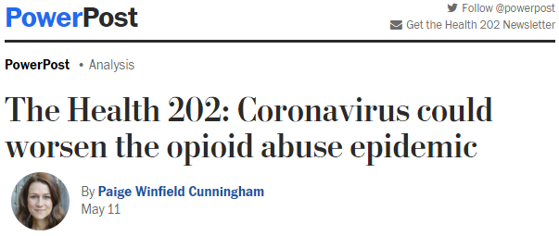
The Future Crisis Post COVID -19

Slide 8
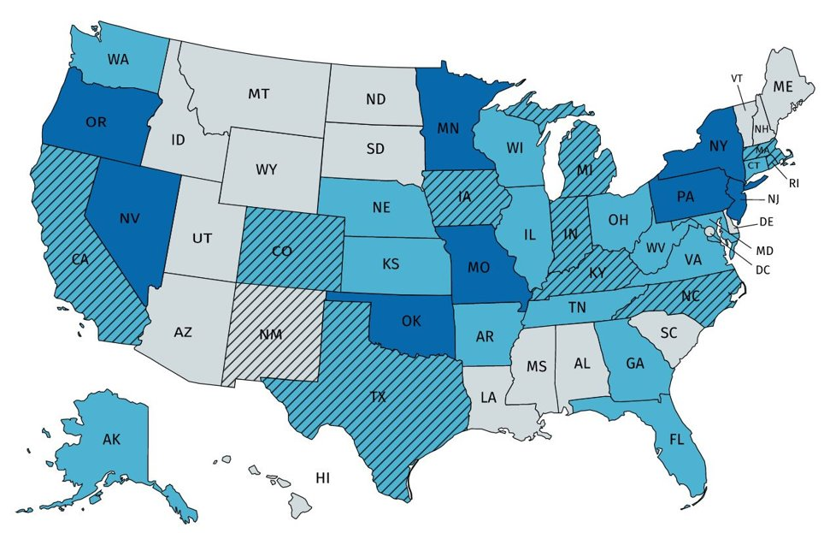
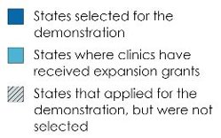
Looking to the Future
$38.5 billion for direct relief to behavioral health providers and organizations
Access to Opioid Use Disorder medication
Long-term telehealth changes, including changes to teleprescribing for OUD
Increased reimbursement rates
Certified Community Behavioral Health Clinics (CCBHCs)
Notes:
Patients need access to medications that work. As the SUD need rises, we won’t be able to meet it with the current restrictions on MAT (specifically prescribing buprenorphine) and telehealth. Many policy decisions need to be held in partnership with the DEA re buprenorphine.
We need to not only focus on increasing reimbursement rates to meet the need of providers who serve people with SUD, but also need to focus on incentivizing doctors to take on patients with SUD if they have not before due to stigma, etc.
We are currently seeing that preventing physical illness is having an impact on mental wellbeing. Having integrated care has now become more important than ever – which is why we’re championing CCBHCs, who cover all BH needs, including OUD.

Slide 9
First-ever Hill Day at Home and Virtual Policy Institute
Register here.
Tuesday, June 23, 12:00 – 4:00 PM ET
Matt Salo, Executive Director, National Association of Medicaid Directors
Representative David Trone (D-MD)
Senator John Cornyn (R-TX)
Breakouts on telehealth, parity and health inequity
Wednesday, June 24
Series of digital advocacy events
Film Screening, Panel 2:00 – 3:30 PM ET

Slide 10
Questions?
Reyna Taylor
Vice President, Public Policy
ReynaT@TheNationalCouncil.org
Questions? Email the National Council Policy Team at Policy@TheNationalCouncil.org
Download the National Council’s survey results.
Hill Day at Home – June 23-24, 2020
Notes:
Information about the Virtual Policy Institute, breakout sessions

Slide 11
Lessons from the Field: Member Experiences During COVID-19
All participants will be divided into breakout rooms for small group discussions for 25 minutes
Each room will have a National Council Board Member designated as facilitator to share their experiences navigating COVID-19
Engage and ask questions (Unmute yourself to speak up)
For technical support, please contact Stephanie Swanson via private chat on Zoom or email (StephanieS@thenationalcouncil.org)

